Slide 1
“My People Shall Be Satisfied”
Jeremiah 31:10-14

Slide 2
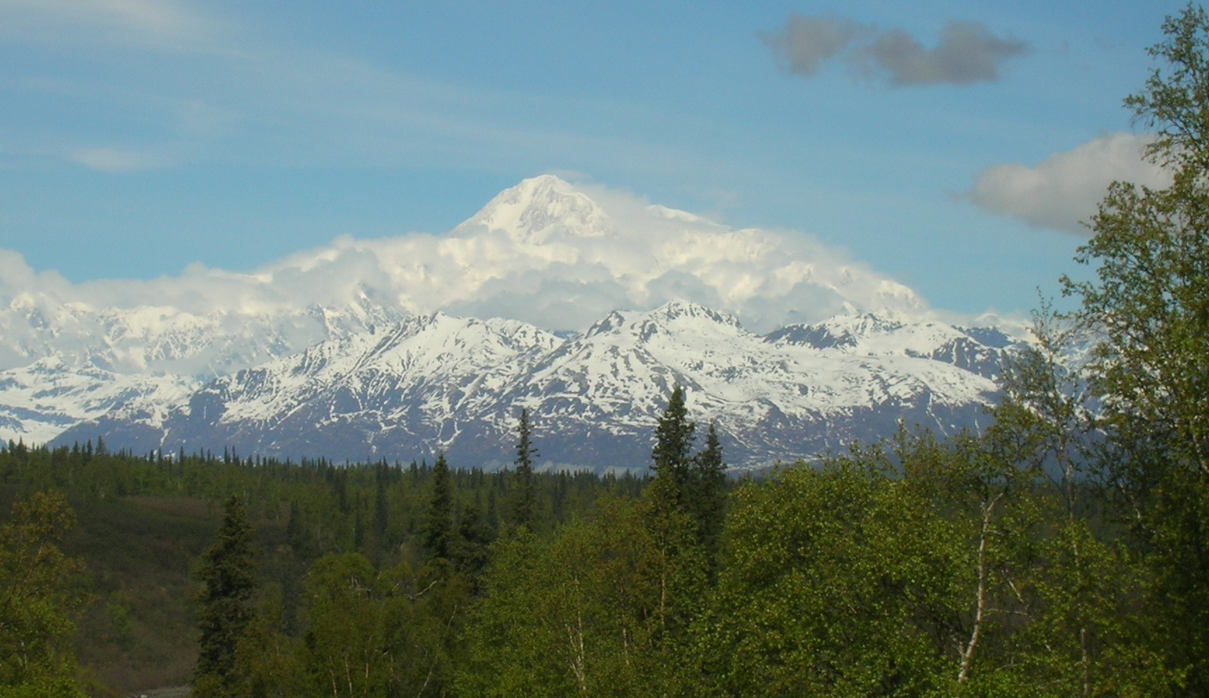
The Context
The Captivity
The Restoration
Blend into Messianic Age

Slide 3
Define Satisfied
Fill to satisfaction (literally or figuratively): have enough, fill (full, self, with), be (to the) full (of), have plenty of, be satiate, satisfy.
Illustration: Popcorn and Water

Slide 4
What Will Not Satisfy
Sin and It’s Pleasures, Heb.11:24-25, Rom.6:21
The Lie of The Devil, Gen.3:5-6
Material Things, Isaiah 55:1-2, Lk.12:15, Jn.6:27
Food, Fun and Frolic Not Satisfy the Soul
The Book of Ecclesiastes

Slide 5
What or Who Will Satisfy
Jer.31:14, God’s Goodness,
Ps.17:15, Be Like God
Ps.23:1-6, Lord is Our Shepherd
Ps.36:7-8, Trusting in God
Prov.19:23, Fear the Lord
Matt.4:4, The Word of God
Matt.5:6, Hunger and Thirst for Righteousness
John 10:10, The Abundant Life
1 Tim.6:7-9, Godliness with Contentment
Rom.8:6-8, Be Spiritually Minded

Slide 6
The Plan of Salvation
Hear the Gospel of Christ, Acts 18:8
Believe in Jesus Christ Rom.5:1
Repent and Turn to God, Luke 24:47
Confess Jesus Before Men, Acts 8:37
Be Baptized for the Remission of Sins, Ac.2:38
---------------------------------
Be Thou Faithful Unto Death, Rev.2:10
If Err From The Faith: Repent and Pray God Acts 8:22

