Slide 1
Jesus Taught…
At the Temple, Lk.2:46
In a Mountain, Matt.5:1
In a Synagogue, Lk.4:16
While walking on the Sea, Mt.14:26 ff
At Simon’s House, Luke 7:36
From a Boat, Matt.13:2
At the Mount of Olives, Matt.24:3
On the Road, Luke 24:32
At a Fig Tree, Matt.21:19
While Riding a Donkey, Luke 19:36 ff

Slide 2
Jesus Teaches Us From The Cross

Slide 3
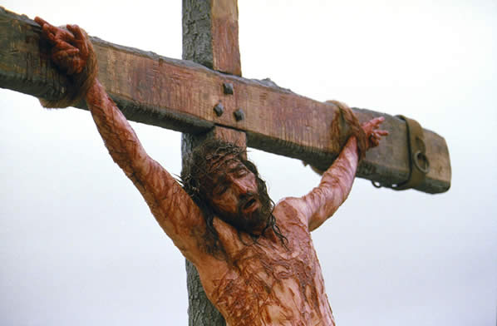
Jesus Teaches Us From The Cross
Words of Mercy and Forgiveness, Luke 23:33-38, Eph.4:31, Acts 7:54-60
Words of Hope, Luke 23:39-43, Heb.9:16-17
Words of Concern For Others, John 19:25-27, Luke 2:34-35
Words of Anguish and Sacrifice, Mark 15:33-36, Ps.22:1, 2 Cor.5:21
Words of His Humanity, John 19:28-29, Heb.2:17, John 4:14
Words of Completion, John 19:30, Heb.10:11-12, Is.53:11, Matt.5:17-18
Words of Faith, Luke 23:46-49, Ps.23:4, Rev.14:13

Slide 4
God’s Plan of Redemption
Hear the Gospel of Christ, Acts 2:22
Believe in Jesus Christ, Rom.1:16
Repent and Turn to God, Luke 13:3
Confess Jesus Before Men, Matt.10:32
Baptized Into Christ, I Pet.3:21
-----------------------------
Grow And Be Faithful, 2 Pet.3:18
If Err As a Christian: Repent and Confess, Acts 19:18

