Slide 1
Don’t Be Robbed
Col.2:8 MKJV
“Beware lest anyone rob you through philosophy and vain deceit, according to the tradition of men, according to the elements of the world, and not according to Christ.”

Slide 2
“Beware”
Metaphorically to see with the mind’s eye
2a) to have (the power of) understanding
2b) to discern mentally, observe, perceive, discover, understand
2c) to turn the thoughts or direct the mind to a thing, to consider, contemplate, to look at, to weigh carefully, examine

Slide 3
“Lest Anyone Rob You”
Satan is Behind it All, 1 Thess.3:5
He Uses Servants, 2 Cor.11:13-15, 1 Tim.4:1
He Will Use Whoever, Whenever, However To Accomplish His Goal
He Wants to Rob You
To lead away as booty. To carry off as booty a captive, slave, maiden.
“Spoils of War”
To Rob you of eternal life, salvation.
How He does it?

Slide 4
“Through Philosophy”
Love of wisdom. Used either of zeal for or skill in any art or science, any branch of knowledge.
Contrast of Wisdom, 1 Cor.2:1-7
Humanism
Dawarinism
Psuedo-Science, “Junk Science” 1Tim.6:20
Denominational Dogma

Slide 5
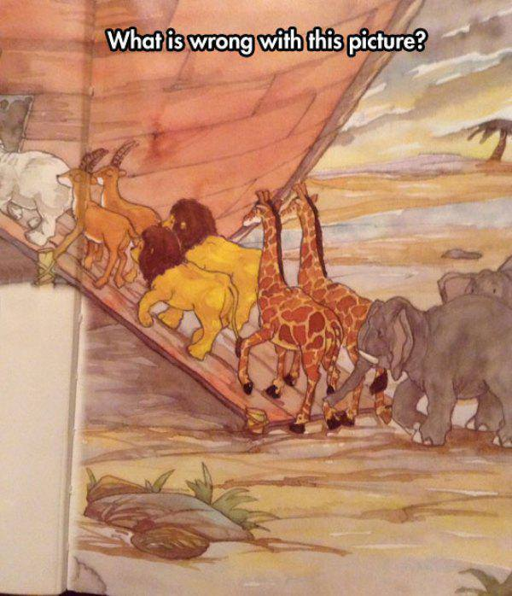
“Vain Deceit”
Empty, vain, devoid of truth. Delusion: - deceit (-ful, -fulness), deceivableness. ~ To cheat, that is, delude.
Prejudicial Arguments, Jn.1:45-46
Any Scholars believe such?
Think you the only bunch going to heaven?
Excuse Making. Too Busy! “I’m Gonna…”
Family Holding me back. Don’t have time.
Immorality, Eph.5:6
Example graphic.

Slide 6
“The Traditions of Men”
A giving over, a passing on. The word is colorless in itself. (The tradition may be good 2Thess.3:6) (Or merely innocent)
Matt.15:2-6
Clinical Baptism – Sprinkling or Pouring
Instrumental Music
Separate Priesthood
Sectarian Names
Pray the Sinners Prayer

Slide 7
“According to the Elements of the World”
Any first thing, from which the others belonging to some series or composite whole take their rise, an element, first principal
ABC’s 123’s
Necessities of Life, Matt.6:27-33
Job, Jn.6:27
Eat, Drink and be Merry, Luke 12:19
Desire to be Accepted, Jn.12:42-43
Various Biological Desires, 1 Jn.2:15-17
“Not According to Christ”
Gal.2:20, Col.3:4, Luke 6:46

Slide 8
The Plan of Salvation
Hear the Gospel of Christ, Mk.16:15
Believe in Jesus Christ, Acts 16:31
Repent and Turn to God, Acts 17:30
Confess Jesus as Lord, Matt.10:32
Be Baptized, I Pet.3:21
----------------------------------
Be Faithful Unto Death, Rev.2:10
If Err: Repent and Pray God, Acts 19:18

