Slide 1
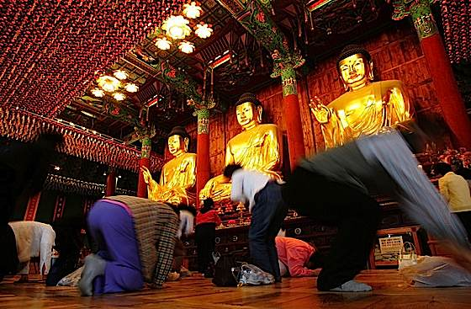
The Subtleness of Idolatry
1 Cor.10:6-11
“Thou shalt have no other gods before me.... Thou shalt not make unto thee a graven image…. Thou shalt not bow down thyself unto them

Slide 2
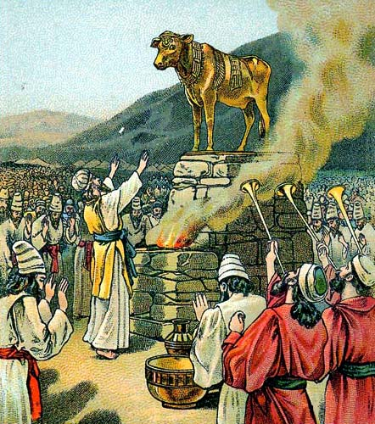
Idol Worship, Ex.32
Historical Event in Exodus 32
Agree to Follow, Ex.19:8, 24:3-8
Soon Forget, Ex.20:2-5
Vs.1-6, Idolatry – vs.8, 19, 25
Vs.7-18, Moses Intercedes
Vs.19-24, Moses Confronts the Problem
Vs.25-35, Wickedness Punished

Slide 3
Idolatry More Subtle Today
Money - Wealth, Mt.6:24
“Weekending”
Vacationing
Sports
Pleasures, Luke 8:14, 2 Tim.3:4
Immorality, Col.3:5
Alcohol and Drugs

Slide 4
God’s Scheme of Redemption
Hear God’s Message, Acts 2:22
Believe in Jesus Christ, Mark 16:16
Repent and Turn to God, Acts 2:38
Confess Jesus Before Men, Matt.10:32
Be Immersed In Water, Mark 16:16
----------------------
Be Thou Faithful Unto Death, Rev.2:10
If You Err From The Truth: Repent and Confess, Ac.19:18

