Slide 1
Welcome To Our Services

Slide 2
Let Us Praise & Worship God
Song Leader – Chris Craig
♫ First Hymn #
♫ Second Song #
Opening Prayer -
♫ Song Before The Lesson #
♫ Invitation Hymn #

Slide 3
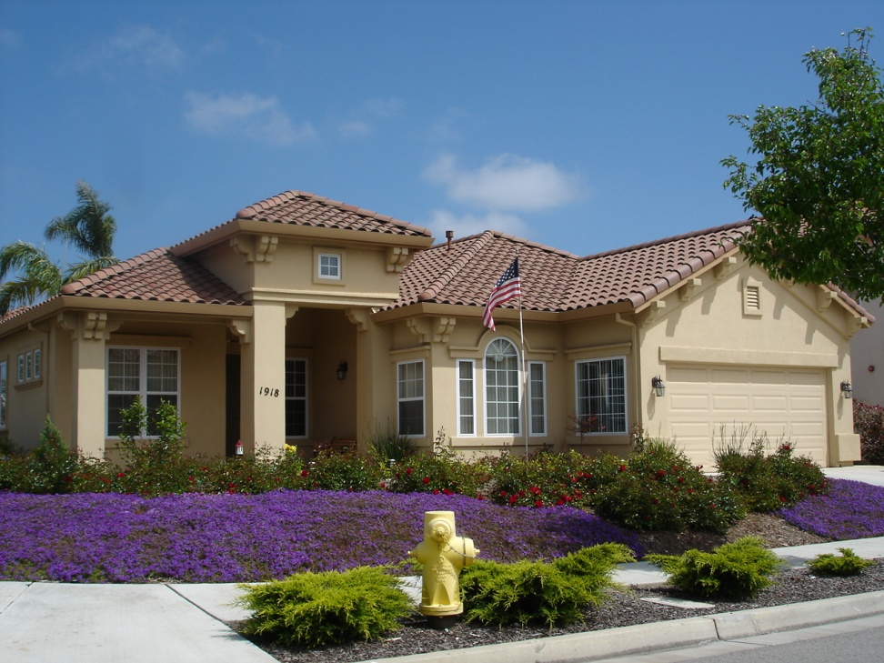
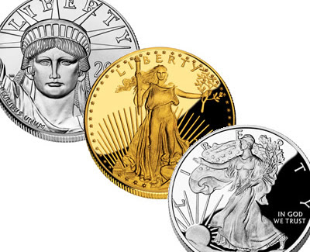
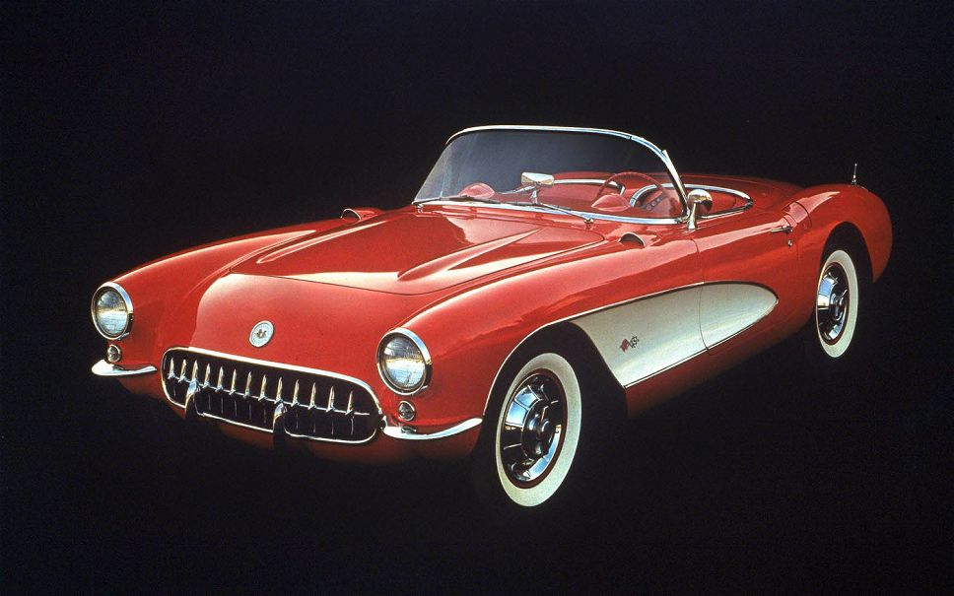
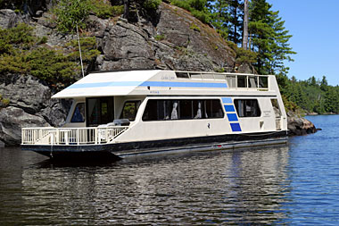
Things Money Can Buy

Slide 4
Things Money Cannot Buy
Manners, Eph.4:32, 1 Pet.2:17
Common Sense, Prov.1:1-9, Rom.1:21-23
Morals, Tit.2:11-12, Rom.1:24ff
Character - Integrity - Class, Rom.5:1-5
Trust – Respect of Others, Pr.22:1, 1Pet.2:12
Patience, Heb.12:1, Jm.1:2-4
Salvation , Is.55:1-3
Love, 1 Jn.4:19, John 3:16
A Home in Heaven, Eph.2:8-10, Rom.6:23

Slide 5
The Plan of Salvation
Hear the Gospel of Christ, Acts 18:8
Believe in Jesus Christ, Acts 2:36
Repent and Turn to God, Acts 2:38
Confess Jesus Before Men, Acts 8:37
Be Baptized for Forgiveness, Ac.22:16
-----------------------
Be Thou Faithful Unto Death, Rev.2:10
If Err From The Faith: Repent and Pray God Acts 8:22

Slide 6
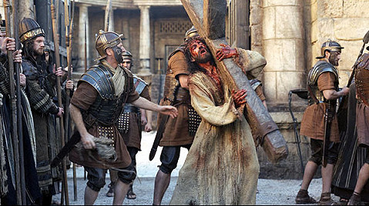
The Lord’s Supper
The governor again said to them, “Which of the two do you want me to release for you?” And they said, “Barabbas.”
Pilate said to them, “Then what shall I do with Jesus who is called Christ?” They all said, “Let him be crucified!”
And he said, “Why, what evil has he done?” But they shouted all the more, “Let him be crucified!” Matt.27:21-23

Slide 7
The Collection
“Now concerning the collection for the saints, as I have given order to the churches of Galatia, even so do ye.
Upon the first day of the week let every one of you lay by him in store, as God hath prospered him, that there be no gatherings when I come.” 1Cor.16:1-2

Slide 8
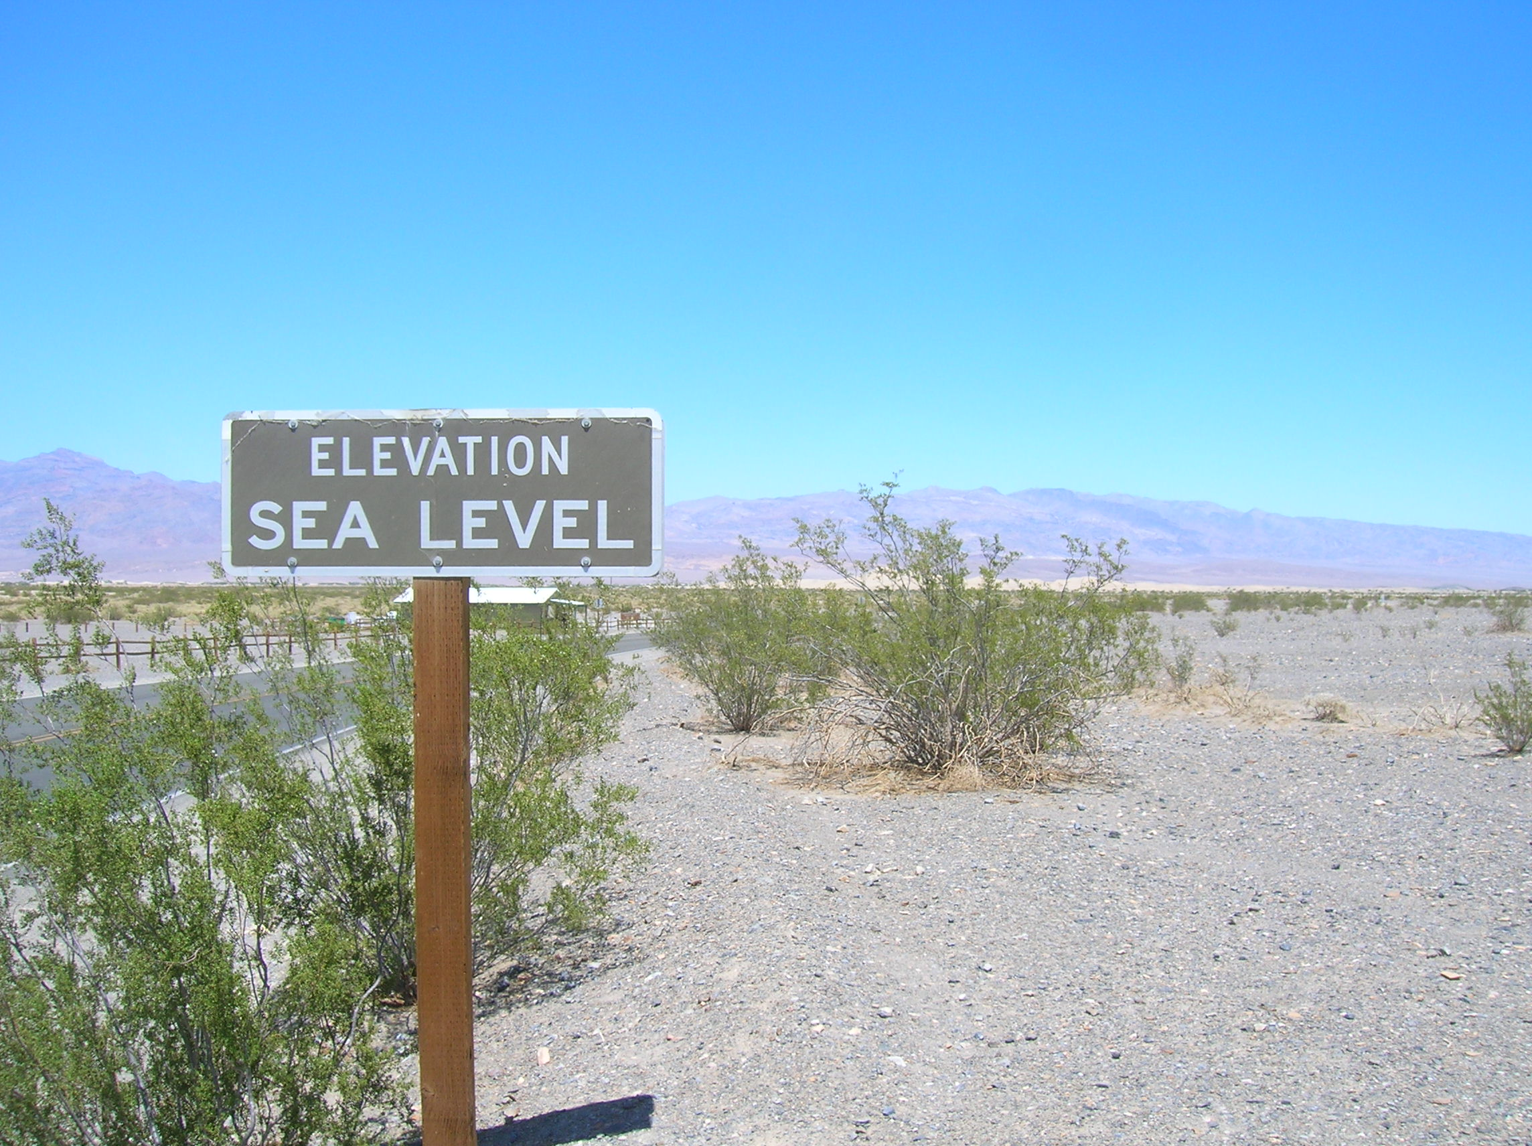
Thanks for Coming Today.
(Death Valley National Park)

