Slide 1
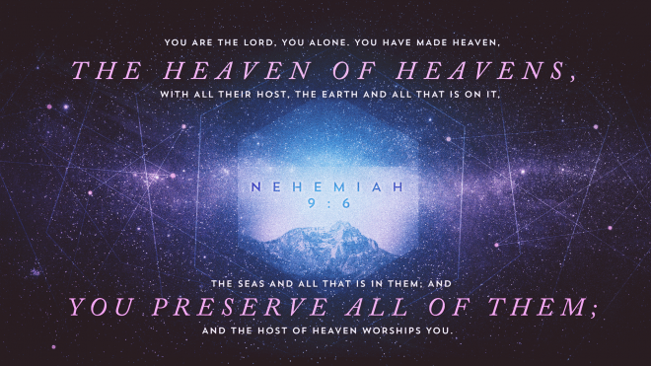
You Are Jehovah

Slide 2
You Are Jehovah, You Alone
(The) self Existent or eternal; Jehovah, Jewish national name of God. “The existing One” Ps.90:2
Plurality of Persons in “Jehovah” Gen.1:26, 3:22, 11:6-8, Deut.6:4
“I Am” Ex.3:13-14
יהוה Jehovah, Yahweh, Yahuah, Yahuweh
Ex.33:18-23, 34:5-6, 14

Slide 3
Jehovah Is The Maker
To do, fashion, accomplish, make, Gen.1:1, John 1:1-3

Slide 4
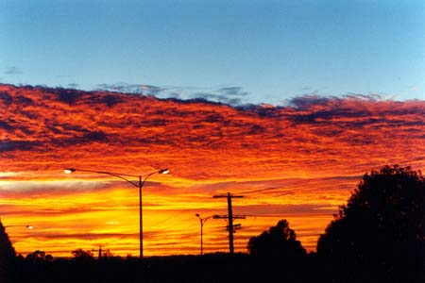
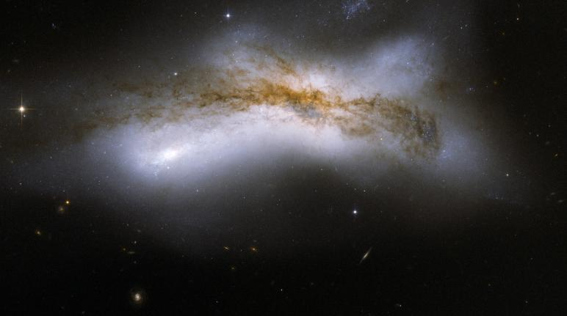
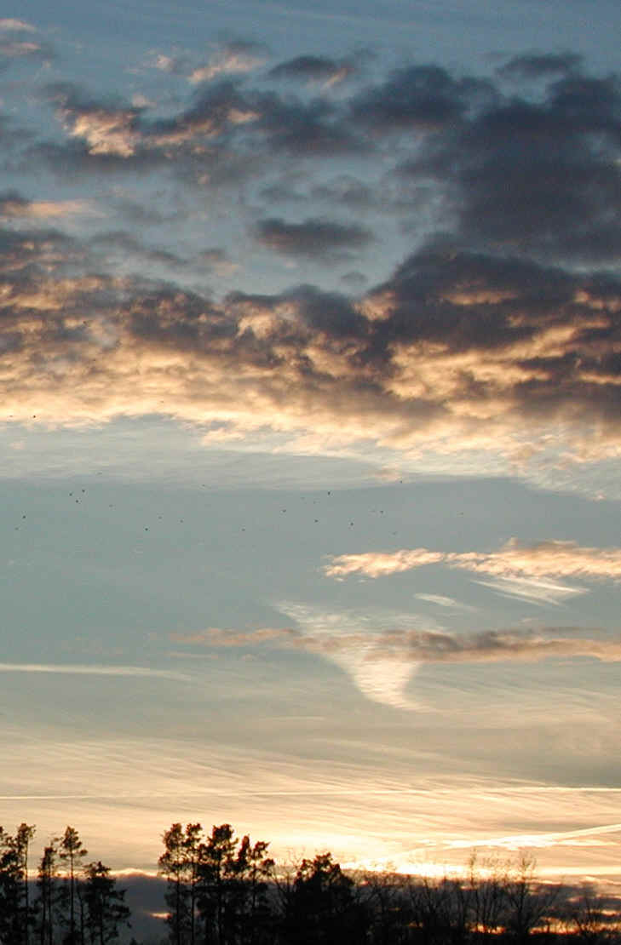
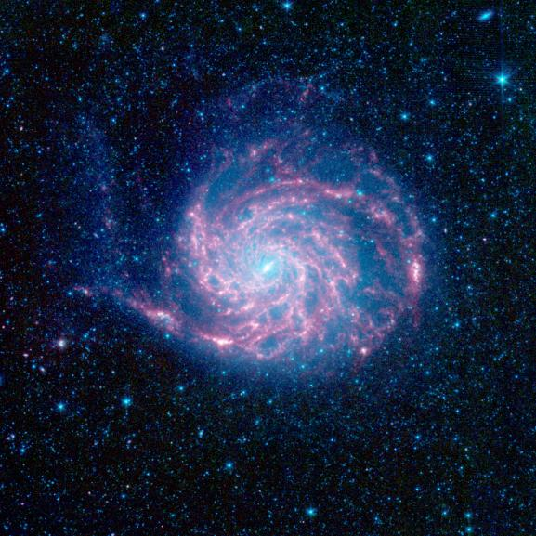
“You have made heaven, the heaven of heavens”
2 Cor.12:2 “Third Heaven”
With all their host, Rev.5:8-14

Slide 5
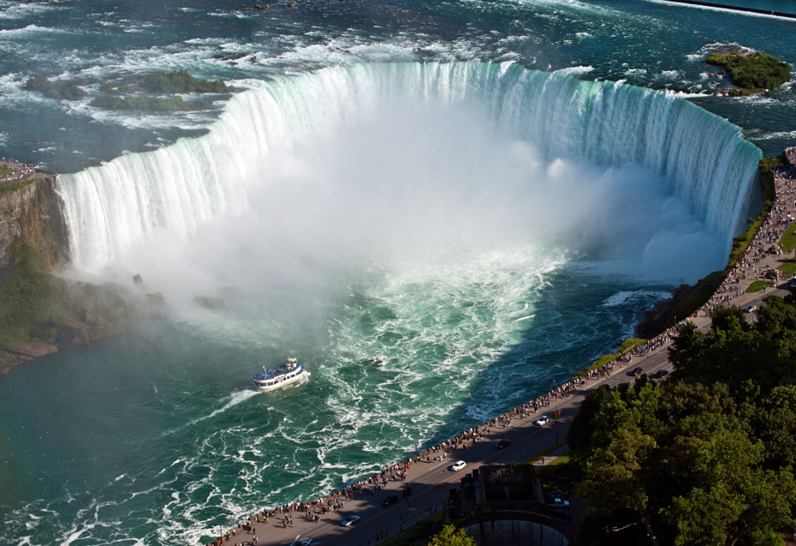
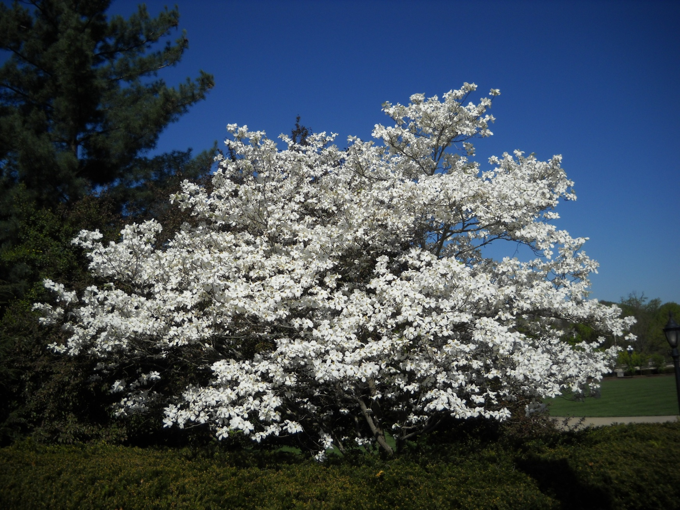
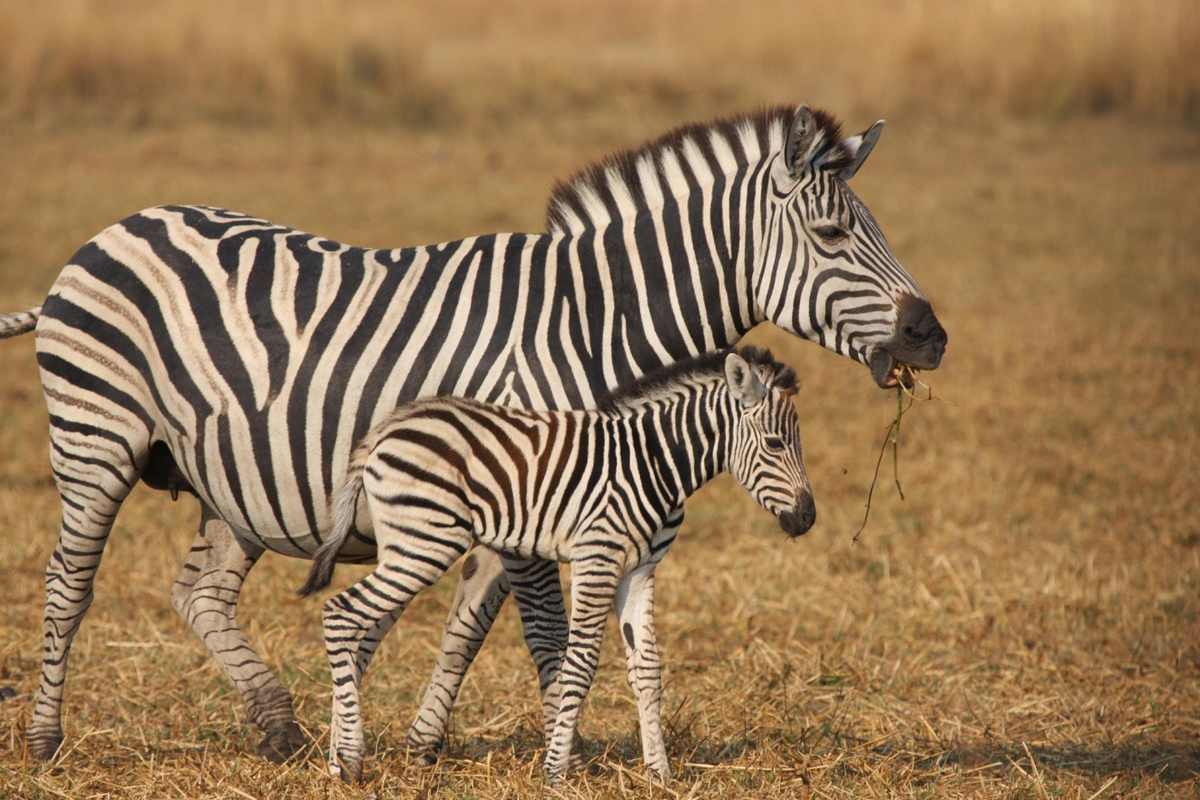
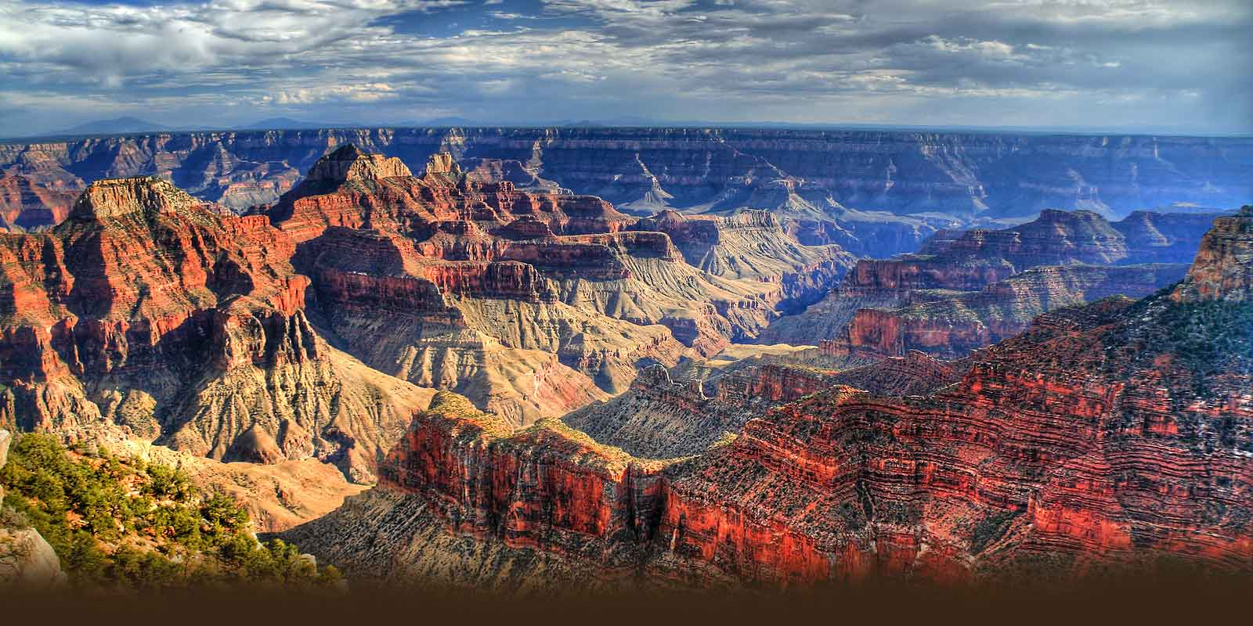
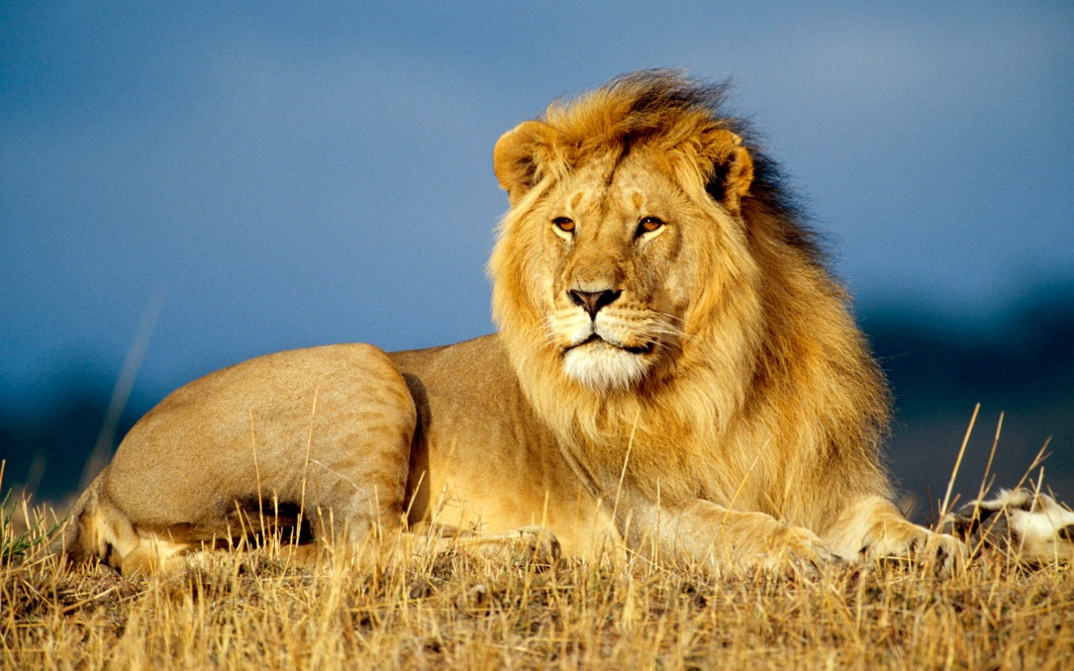
“The earth and all that is on it”

Slide 6
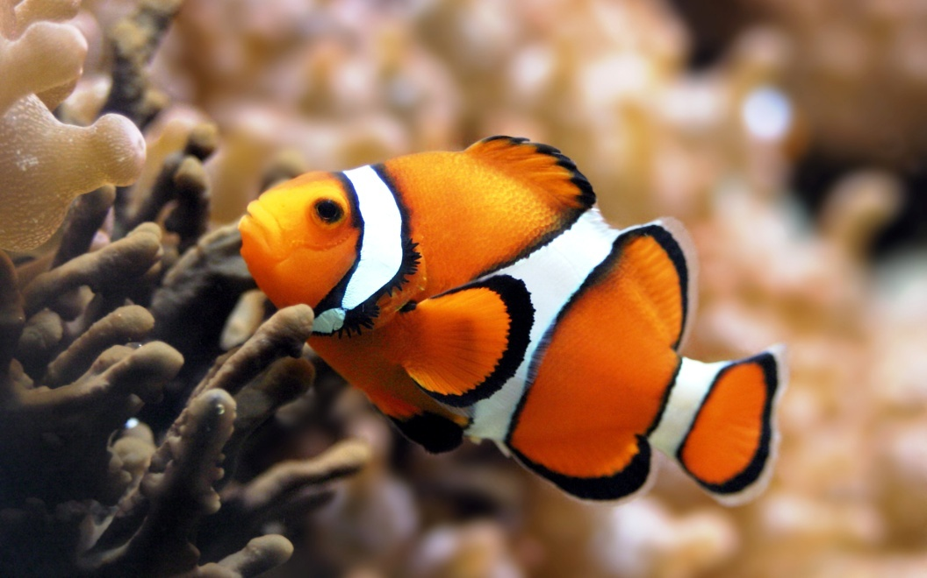
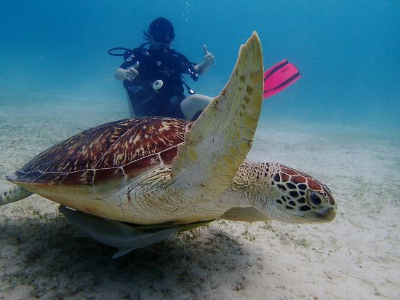
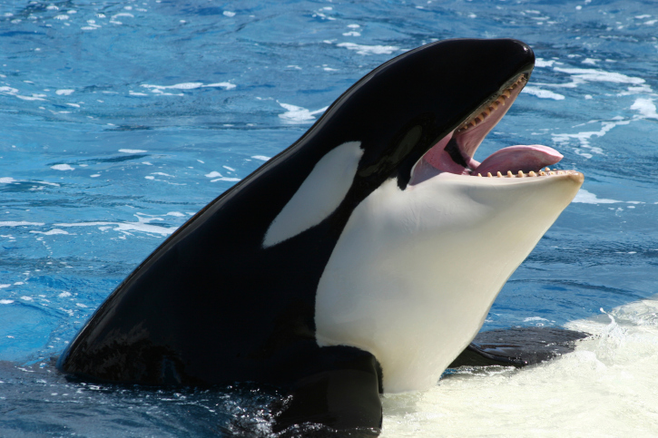
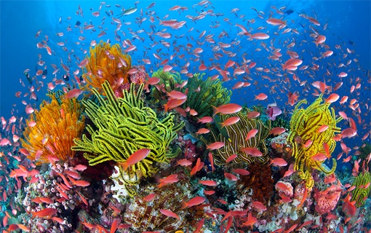
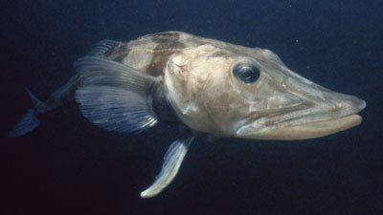
“The seas, and all that is therein”

Slide 7
“And you preserve all of them”
Matt.6:26-31
Acts 14:15-17
Col.1:16-17
Heb.1:2-3

Slide 8
“And the host of heaven worships you.”
Rev.5:11-14
Matt.4:10
Rev.22:8-9
What About You?
What About Me?

Slide 9
The Plan of Salvation
Hear the gospel of Christ, Acts 2:22
Believe in Jesus Christ, Acts 16:31
Repent and Turn to God, Acts 17:30
Confess Jesus Before Men, Acts 8:37
Be Baptized For Forgiveness, Acts 2:38
---------------------------------------
Cleave Unto The Lord, Acts 11:23
If Err You As A Christian: Repent & Pray God Acts 8:22

