Slide 1
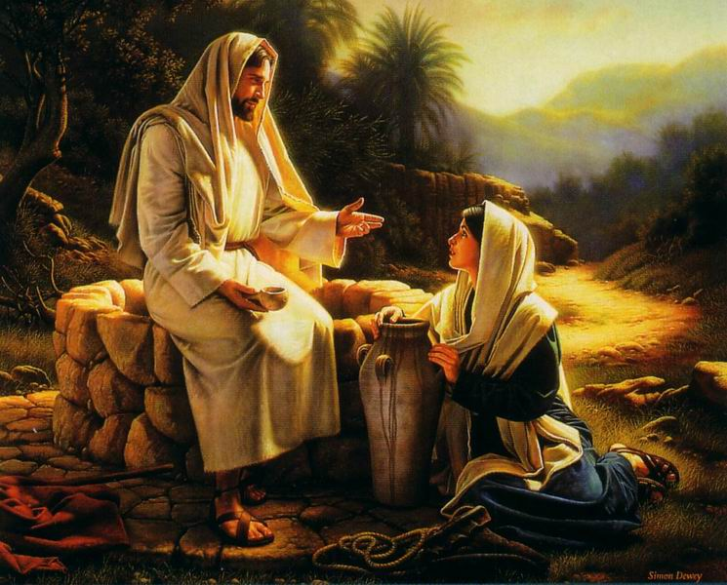
John 4:1-34

Slide 2
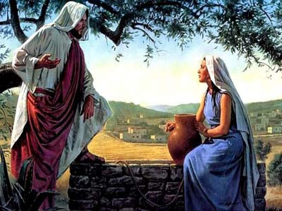
Jesus and the Samaritan Woman
The Humanity of Jesus
Not Prejudice
Turned the Discussion
God Conscious Life
Personal Evangelism
The Hidden Treasure
Not “Write Her Off”
God Energizes Us
All Can Be Accepted
The Woman Was Excited

Slide 3
The Plan of Salvation
Hear the Gospel of Christ, Rom.10:17
Believe in Jesus Christ, Acts 16:31
Repent and Turn to God, Luke 13:5
Confess Jesus Before Men, Acts 8:37
Be Baptized for the Remission of Sins, Ac.2:38
---------------------------
Be Thou Faithful Unto Death, Rev.2:10
If Err as a Christian: Repent & Confess, Acts 19:18

