Slide 1
Mass Murders
Sandy Hook Elementary School - Newtown, Connecticut
Virginia Tech in Blacksburg, Virginia.
Columbine High School - Littleton, Colorado.
Aurora, Colorado, at a movie theater.
Fort Hood, Texas.

Slide 2
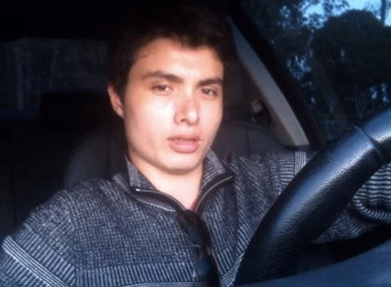
“My Revenge Against Humanity”
“The Day of Retribution”
Elliot Rodger
His Manifesto: “My Twisted World.”
137 page, 107000 word Journal of his Life. Allows insight in the mind of killer.

Slide 3
Blaming the Wrong Things
Violent Video Games
Violent Movies
Guns – Politicians, NRA.
What about the Knives? Car?
Mental Illness – Asperger’s Syndrome
Like People Talk about “Alcoholism”

Slide 4
Parents Have Big Responsibilities
Eph.6:4
2 Tim.3:14
Deut.6:6-9
Prov.22:6
Prov.19:18
Prov.29:15
Not Churches
Family at large
Not Schools
Not Society

Slide 5
Blundered Into Many Sins
Absence of God, Evolution
Arrogant, Haughty, Pride, Pr.16:18
Jealousy and Envy, Gen.37:33, Pr.14:30, Mt.27:18
Racism, Prejudice, Jam.2:9
Spirit of Revenge, Rom.12:19
Wrong View of Women, Gen.1:27
Love of Money, 1 Tim.6: 6-10
Anger, Hatred, Eph.4:26-27
Alcohol, Prov.20:1

Slide 6
But God Can Forgive
Hear the Gospel of Christ, Mk.16:15
Believe in Jesus Christ, Rom.5:1
Repent and Turn to God, Acts 17:30
Confess Jesus as Lord, Rom.10:9-10
Be Baptized, I Cor.12:13
----------------------------------
Be Faithful Unto Death, Rev.2:10
If Err: Repent and Pray God, Acts 19:18

