Slide 1
Welcome To Our Services
Custer State Park, SD

Slide 2
Let’s Worship In Spirit & In Truth
Song Leader – Chris Craig
♫ First Hymn #
♫ Second Song #
First Prayer -
♫ Song Before The Lesson #
♫ Invitation Song #
♫ Closing Hymn #

Slide 3
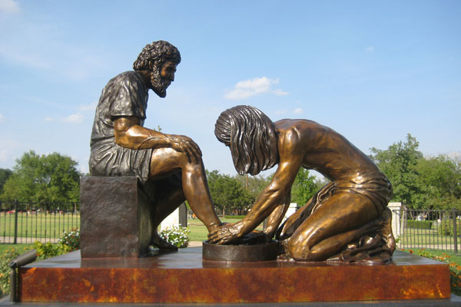
The Divine Servant
John 13:1-17

Slide 4
The Divine Servant
The Question They Argued About?
Who is the Greatest? Lk.22:24-27
Argued Other Times, Mt.18:1-4, 20:20-28
The Nature of Jesus, Mt.1:23, Jn.1:1-3, Phil.2:5-8
2 Qualities of Greatness: Humility – Servitude
Jesus Visual Aid, Object Lesson, Jn.13:1-17
5 Things Jesus Knew, Hour Was Come vs.1
All Things Given Unto Him, vs.3
Come From God, vs.3
Went to God, vs.3
Who Would Betray Him, vs.11

Slide 5
Our Manner of Serving
When Should We Serve? Lk.10:30-37, Eph.5:16
Where Should We Serve? Eph.6:4, Col.3:23
How Can I Serve? Mk.14:3-9, Ac.9:36, 39
No Committee, No Permission
Who Can I Serve? Lk.10:29, Jm.2:1-0, Mt.25:34ff
Serve Faithfully, Gal.6:7-10, Rom.13:8
Not Broadcast Your Deeds, Mt.6:1-4, Mt.23:5
If Ye Know These Things, Happy Are Ye… vs.17

Slide 6
God’s Plan to Save Humanity
Hear the Gospel of Christ, Rom.10:17
Believe in Jesus Christ, Acts 2:36
Repent and Turn to God, Acts 2:38
Confess Jesus Before Men, Matt.10:32
Baptized Into Christ, Gal.3:26-27
-----------------------------
Grow And Be Faithful, 1 Pet.2:2
If We Err From The Faith, Acts 8:22

Slide 7
Thanks For Coming
Alaskan Glaciers from 36,000 feet

