Slide 1
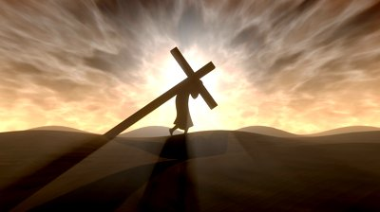
One aspect of taking up our cross and following Jesus is
doing right even when
we know
HARM
AWAITS
“If anyone desires
to come after Me, let him deny himself, and take up his cross, and follow Me.” (Matthew 16:24)
Such characterized the life of Jesus
Such characterized the ministry of Paul
And US??
Consider a closing example: the apostles (Acts 4,5)
Why?
His desire that the Father’s will be done
His concern for His fellow man
--Matthew 16:21
--Matthew 17:22-23
--Matthew 20:17-19
Why?
His desire that the Father’s will be done
His concern for His fellow man
--Romans 15:25-31
--Acts 20:22-23
--Acts 21:10-13
Preaching in tough situations
Talking to the fallen
Refusing unethical practices
Choosing Jesus over family
Opposing school officials
Disciplining a fellow member

