Slide 1
Choices, Choices, Choices
Making Choices in Life
Some Choices are Complex - Some Choices are Simple

Slide 2
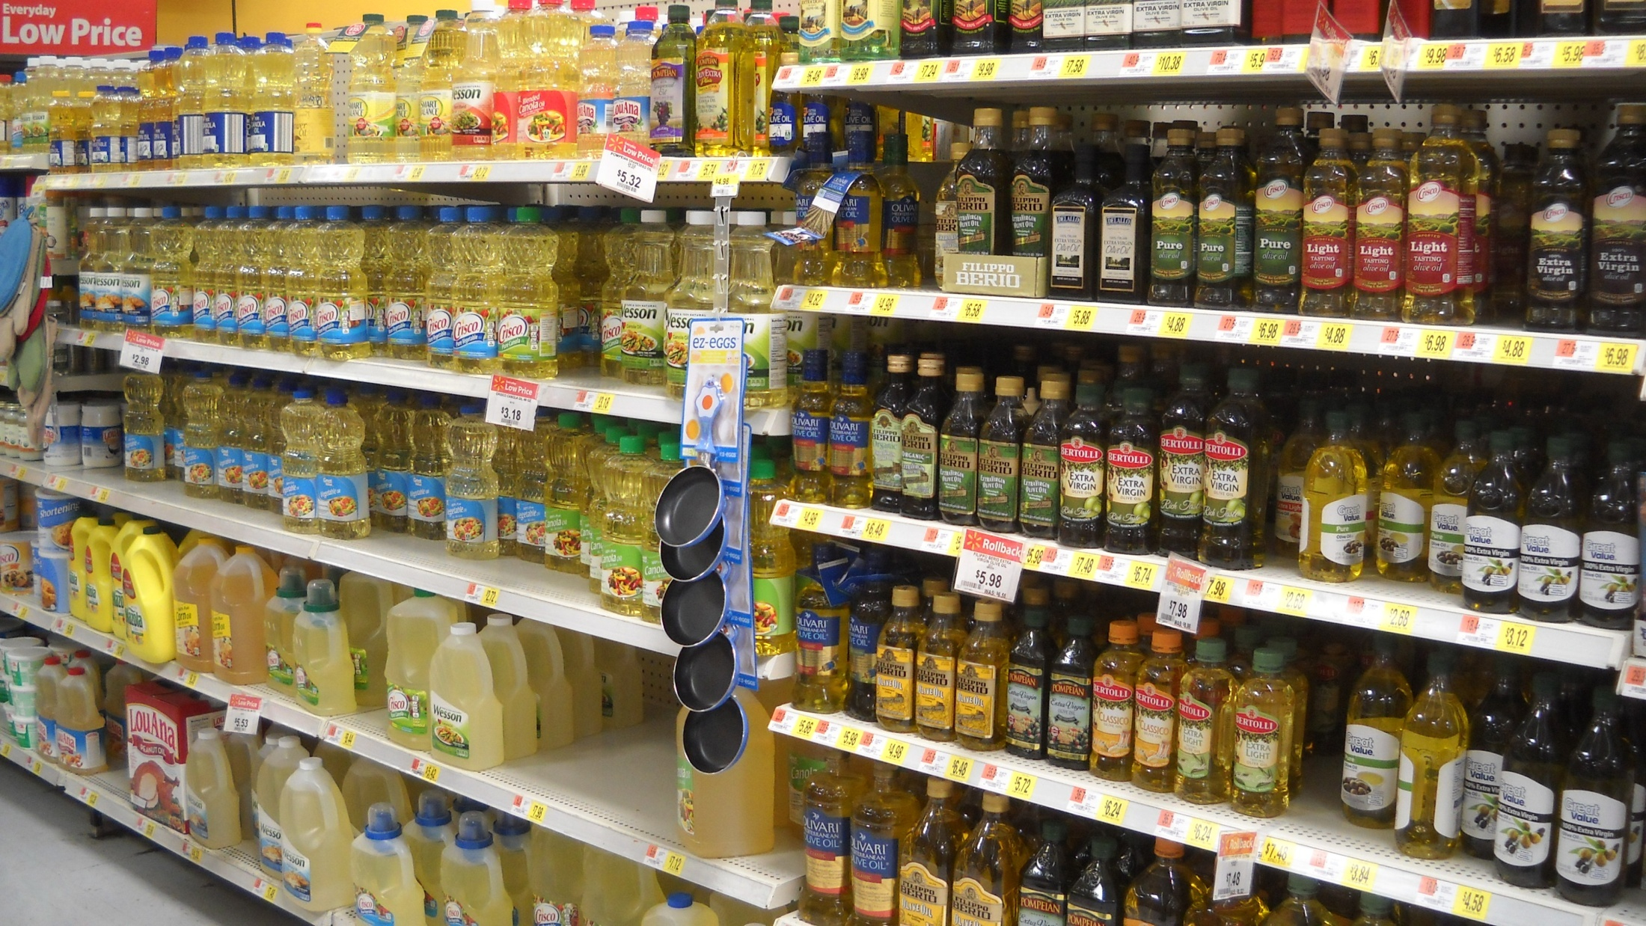
Some Choices Are Complex
“Stop and pick up some cooking oil”

Slide 3
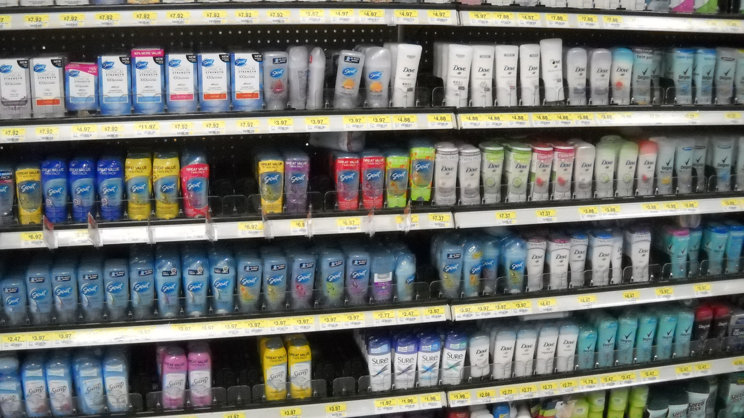
Some Choices Are Complex
“We need some deodorant”

Slide 4
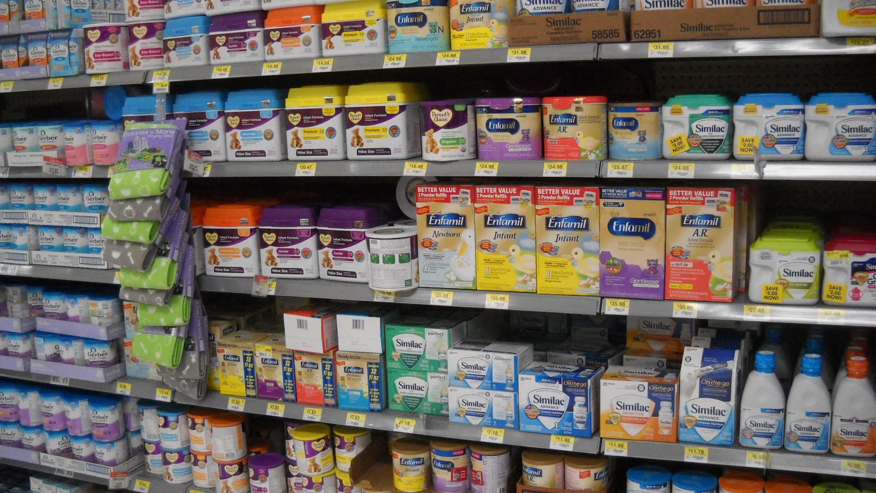
Some Choices Are Complex
“Just get some baby formula”

Slide 5
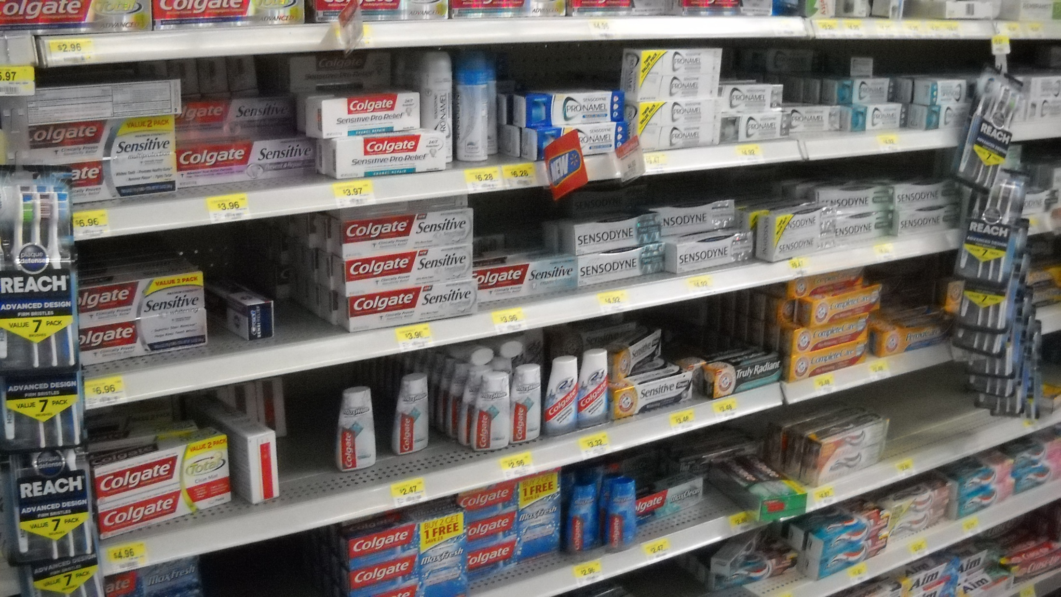
Some Choices Are Complex
“We are out of toothpaste”

Slide 6
Some Choices Are Simple
Matt.12:30, For the Lord or Against the Lord
Matt.12:30, Gather With or Scatter Abroad
Josh.24:14-15, Serve Jehovah or False gods
Matt.3:11-12, Wheat or Chaff
Gal.5:16-23, Walk in the Spirit or In the Flesh
Matt.6:22-23, Singleness of Eye or Evil Eye
Matt.6:24, Serve God or Serve Mammon
Rom.8:6-7, Spiritually Minded or Carnally Minded
Matt.7:24-27, Wise Man or Foolish Man
Matt.25:31-34 Sheep or Goat

Slide 7
The Plan of Salvation
Hear the gospel of Christ, Rom.10:17
Believe in Jesus Christ, Acts 16:31
Repent and Turn to God, Luke 13:3
Confess Jesus Before Men, Acts 8:37
Be Baptized for the Remission of Sins, Ac.2:38
---------------------------
Be Thou Faithful Unto Death, Rev.2:10
If Err as a Christian: Repent and Pray God Acts 8:22

