Slide 1
You ARE a role model
1 Timothy 4:12
Philippians 2:15-16
Titus 2:7
Being good role models:
Why You Want To Think Seriously About This

Slide 2
You ARE a role model
You don’t always know
who’s watching
Galatians 2:11-13
Matthew 26:69-71
1 Timothy 5:25
Daniel 6:10-11
Being good role models:
Why You Want To Think Seriously About This

Slide 3
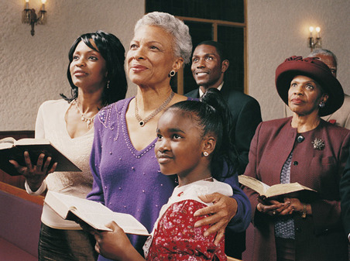
You ARE a role model
You don’t always know
who’s watching
You want to glorify
God in all you do
Isaiah 43:7
Matthew 5:14-16
Being good role models:
Why You Want To Think Seriously About This

Slide 4
You ARE a role model
You don’t always know
who’s watching
You want to glorify
God in all you do
You want to help as many
get to heaven as you can
1 Cor. 10:31-33
1 John 2:10
Matthew 18:6-7
Being good role models:
Why You Want To Think Seriously About This

Slide 5
You are a role model
You don’t always
Know who’s watching
You want to glorify
God in all you do
You want to help as many
get to heaven as you can
Your influence lasts & lasts
Being good role models:
Why You Want To Think Seriously About This

Slide 6
TAKE YOUR CHILD
“Jonathan Edwards lived in the same state, at the same time as Jukes. He loved the Lord and taught his children the Bible and about God and saw to it that his children were in church every Sunday, as he served the Lord to the best of his ability. He has had 929 descendants – of these 430 were ministers; 86 became university professors; 13 became university presidents; 75 authored good books; 5 were elected to the United States Congress, and two to the Senate.
One was Vice President of his
nation. His family never cost the state one cent but has contributed immeasurably to the life of plenty in this land today.”
“Max Jukes lived in New York. He did not believe in Christ or in Christian training. He refused to take his children to church, even when they asked to go. He has had 1,026 descendants – 300 were sent to prison for an average term of 13 years; 190 were public prostitutes; 680 were admitted alcoholics. His family, thus far, has cost
the state in excess of $420,000. They made
no contribution to society.

