Slide 1
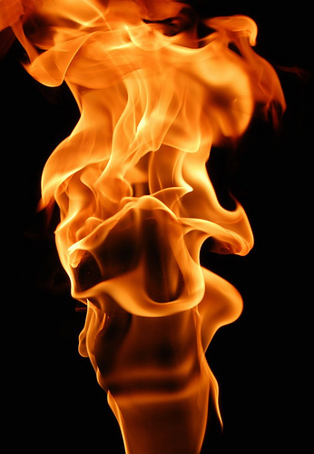
What Did He NOT Accomplish?
Jehoiakim’s Burning of the Scroll:
What Made Him So Angry?
What Did He Accomplish?
He and his people were being
told about their sins.
They were being told they
would go into captivity.
Meanwhile, false prophets
were telling them what they wanted to hear.
He did not destroy God’s word!
He did not prevent the
fulfillment of God’s
prophecies.
He did not remove God’s word
as the standard of judgment.
He succeeded in showing
contempt for God & His word.
He succeeded in bringing God’s
wrath upon himself.
He succeeded in showing
himself to be a stubborn, irrational, rebellious ruler.
“And it happened, when Jehudi had read three or four columns, that the king cut it with the scribe’s knife and cast it into the fire that was on the hearth, until all the scroll was consumed in the fire…” (Jeremiah 36:23)

Slide 2
Is There Any Possibility That We Have Acted Like Jehoiakim?
“And it happened, when Jehudi had read three or four columns, that the king cut it with the scribe’s knife and cast it into the fire that was on the hearth, until all the scroll was consumed in the fire…” (Jeremiah 36:23)

