Slide 2
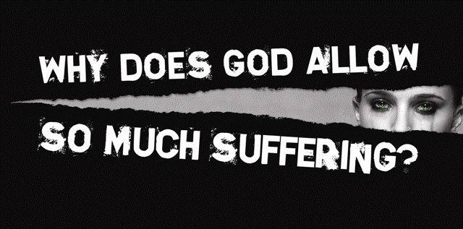

Slide 3
Why Does God Allow So Much Suffering?
* Why God allows it
* Why Christians can even rejoice in the midst of trials!

Slide 4
Why Does God Allow So Much Suffering?
SUFFERING KEEPS THIS WORLD FROM BECOMING TOO ATTRACTIVE
Phil. 3:20; Heb. 11:13

Slide 5
²⁰ For our citizenship is in heaven, from which we also eagerly wait for the Savior, the Lord Jesus Christ,
Phil. 3 (NKJ)

Slide 6
¹³ These all died in faith, not having received the promises, but having seen them afar off were assured of them, embraced them and confessed that they were strangers and pilgrims on the earth.
Heb. 11 (NKJ)

Slide 7
Why Does God Allow So Much Suffering?
SUFFERING CAN BRING OUT OUR BEST
Rom. 5:3-4

Slide 8
³ More than that, we rejoice in our sufferings, knowing that suffering produces endurance,
⁴ and endurance produces character, and character produces hope,
Rom. 5 (ESV)

Slide 9
Why Does God Allow So Much Suffering?
SUFFERING GIVES AN OCCASION TO SILENCE THE ENEMIES OF GOD
1 Pet. 2:15

Slide 10
¹⁵ For this is the will of God, that by doing good you may put to silence the ignorance of foolish men ---
1 Pet. 2 (NKJ)

Slide 11
Why Does God Allow So Much Suffering?
SUFFERING MAKES US APPRECIATIVE
Phil. 1:3-8

Slide 12
³ I thank my God upon every remembrance of you,
⁴ always in every prayer of mine making request for you all with joy,
⁵ for your fellowship in the gospel from the first day until now,
⁶ being confident of this very thing, that He who has begun a good work in you will complete it until the day of Jesus Christ;
⁷ just as it is right for me to think this of you all, because I have you in my heart, inasmuch as both in my chains and in the defense and confirmation of the gospel, you all are partakers with me of grace.
⁸ For God is my witness, how greatly I long for you all with the affection of Jesus Christ.
Phil. 1 (NKJ)

Slide 13
Why Does God Allow So Much Suffering?
SUFFERING MAKES US MORE DEPENDENT UPON GOD
Acts 17:28

Slide 14
²⁸ for in Him we live and move and have our being, as also some of your own poets have said, 'For we are also His offspring.'
Acts 17 (NKJ)

Slide 15
Why Does God Allow So Much Suffering?
SUFFERING HELPS PURIFY US
1 Pet. 1:6-7; Jam. 1:2-5

Slide 16
⁶ In this you greatly rejoice, though now for a little while, if need be, you have been grieved by various trials,
⁷ that the genuineness of your faith, being much more precious than gold that perishes, though it is tested by fire, may be found to praise, honor, and glory at the revelation of Jesus Christ,
1 Pet. 1 (NKJ)

Slide 17
² My brethren, count it all joy when you fall into various trials,
³ knowing that the testing of your faith produces patience.
⁴ But let patience have its perfect work, that you may be perfect and complete, lacking nothing.
⁵ If any of you lacks wisdom, let him ask of God, who gives to all liberally and without reproach, and it will be given to him.
Jam. 1 (NKJ)

Slide 18
Why Does God Allow So Much Suffering?
SUFFERING MAKES US SYMPATHETIC
2 Cor. 1:3-4; Heb. 4:15

Slide 19
³ Blessed be the God and Father of our Lord Jesus Christ, the Father of mercies and God of all comfort,
⁴ who comforts us in all our tribulation, that we may be able to comfort those who are in any trouble, with the comfort with which we ourselves are comforted by God.
2 Cor. 1 (NKJ)

Slide 20
¹⁵ For we do not have a High Priest who cannot sympathize with our weaknesses, but was in all points tempted as we are, yet without sin.
Heb. 4 (NKJ)

Slide 21
Why Does God Allow So Much Suffering?
SUFFERING TEACHES US HOW TO PRAY
Acts 12:5; Eph. 6:18; Rom. 8:26

Slide 22
⁵ So Peter was kept in prison, but earnest prayer for him was made to God by the church.
Acts 12 (ESV)

Slide 23
¹⁸ praying always with all prayer and supplication in the Spirit, being watchful to this end with all perseverance and supplication for all the saints ---
Eph. 6 (NKJ)

Slide 24
²⁶ Likewise the Spirit also helps in our weaknesses. For we do not know what we should pray for as we ought, but the Spirit Himself makes intercession for us with groanings which cannot be uttered.
Rom. 8 (NKJ)

Slide 25
⁸ " For My thoughts are not your thoughts, Nor are your ways My ways," says the LORD.
⁹ " For as the heavens are higher than the earth, So are My ways higher than your ways, And My thoughts than your thoughts.
Isa. 55 (NKJ)

Slide 26
³⁵ Who shall separate us from the love of Christ? Shall tribulation, or distress, or persecution, or famine, or nakedness, or peril, or sword?
³⁶ As it is written: " For Your sake we are killed all day long; We are accounted as sheep for the slaughter."
³⁷ Yet in all these things we are more than conquerors through Him who loved us.
³⁸ For I am persuaded that neither death nor life, nor angels nor principalities nor powers, nor things present nor things to come,
³⁹ nor height nor depth, nor any other created thing, shall be able to separate us from the love of God which is in Christ Jesus our Lord.
Rom. 8 (NKJ)

Slide 27
GOD’S SIMPLE PLAN FOR SALVATION
Baptism
1 PET. 3:21
F
A
I
T
H
F
U
L
Confess
Rm. 10:10
Repent
LK. 13:3
Believe
Mk. 16:16
Rm. 10:17
hear
Rev. 2:10
Notes:
The necessity of being faithful after baptism until death is taught from Revelation 2:10.

Slide 29
Preached at:
Vaught Ridge – 2/16/2014
Providence – 2/16/2014

