Slide 1
The Body of Christ
Eph.1:21-23, Col.1:18

Slide 2
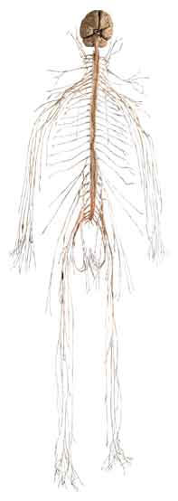
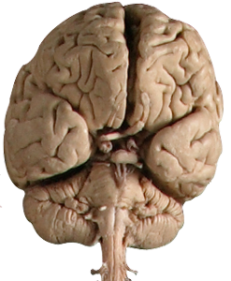
Nervous System
Lines of Communication
Jesus Speaks to Us
Eph.1:22, Jn.12:48, 1 Thess.4:8
We Speak to God – Matt.6:5-8
Why Ask? We See the Need
We Want the Help
Expression of Faith, Jm.1:5-8

Slide 3
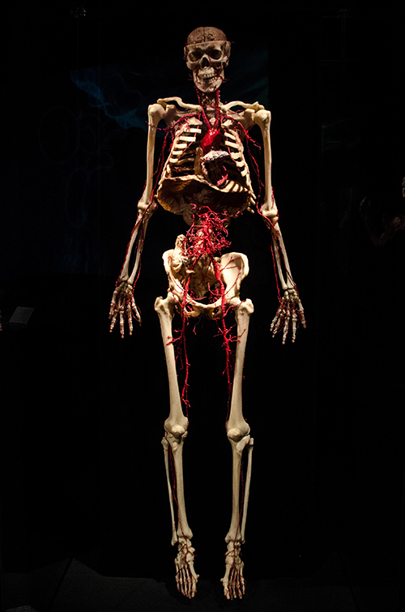
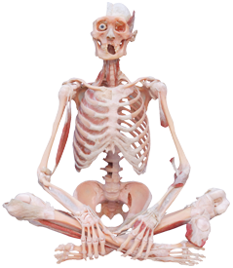
Skeletal System
Rigid, Inflexible, Unchangeable, Unbending
Law of Christ
Eph.4:4-7
Heb.4:12

Slide 4
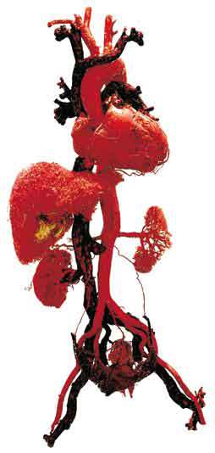
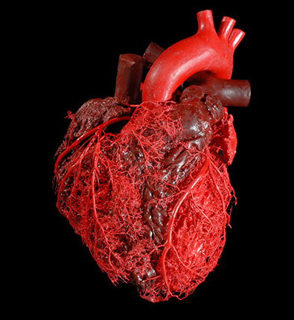
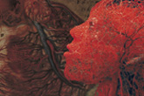
Circulatory System
Warm Blooded
Warmth of Brotherly Love
Rom.12:10
Rom.12:15, 1 Cor.12:26
Acts 9:36-39, 2 Cor.1:3-7

Slide 5
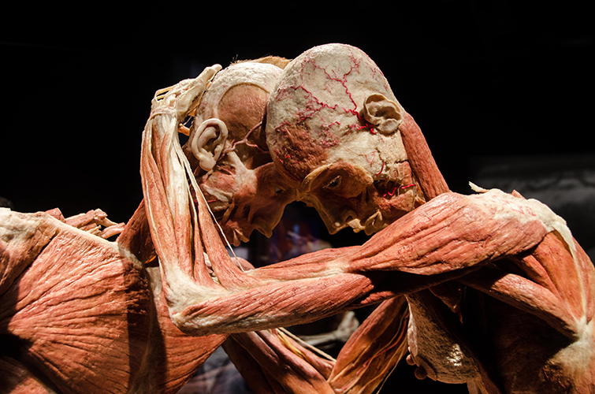
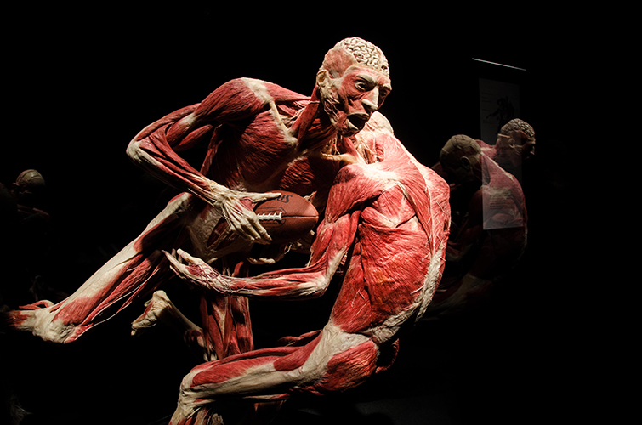
Muscular System
Faith in Action
Muscles Are Made to Work
2 Tim.4:7-8
Heb.5:14
1 Cor.15:58

Slide 6
Digestive Tract
Nourishment of the Body
1 Peter 2:2
1 Peter 5:1-2
Matthew 4:4

Slide 7
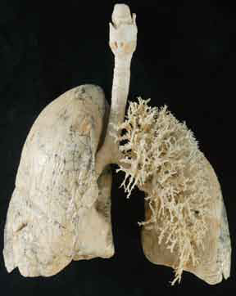
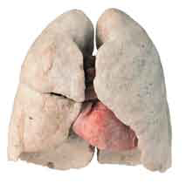
Respiratory System
Worshipping God
Ps.42:1-2
Heb.13:15-16
1 Peter 2:9
Matt.4:8-10

Slide 8
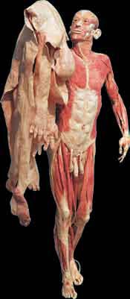
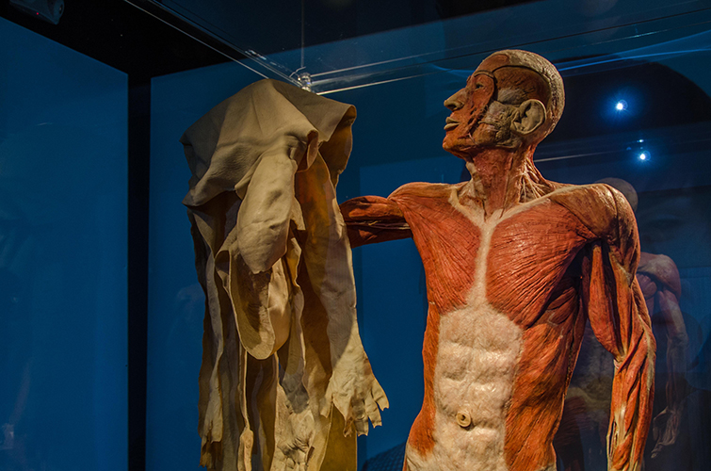
Skin - “Coat of Armor”
Hope – 1 John 3:1-3
Faith – Eph.6:16
Love – Rom.8:35-39

Slide 9
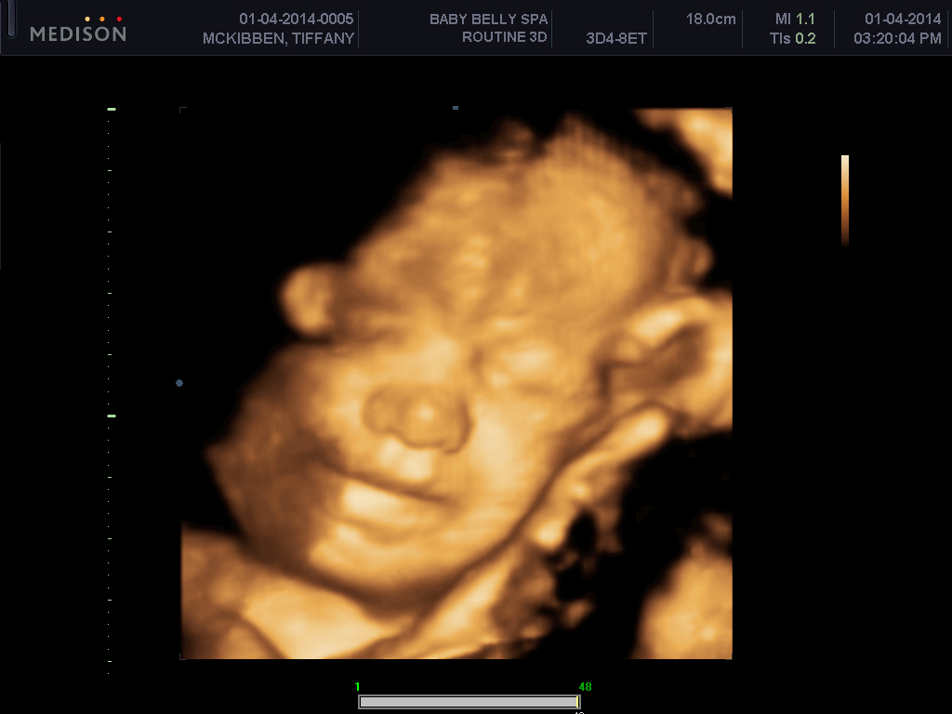
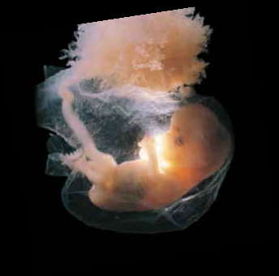
Reproductive System
Gen.1:28
James 1:18
1 Peter 1:23-25
John 3:1-8

Slide 10
Have You Been Born Again?
Hear the Gospel of Christ, Acts 18:8
Believe in Jesus Christ, Rom.5:1
Repent and Turn to God, Luke 24:47
Confess Jesus Before Men, Matt.10:32
Baptized Into Christ, Gal.3:26-27
-----------------------------
Grow And Be Faithful, 2 Pet.3:18
If An Erring Christian: Repent and Pray God, I Jn.1:9

