Slide 1
“In Triumphal Procession”
2 Cor.2:14-16 ESV
14 But thanks be to God, who in Christ always leads us in triumphal procession, and through us spreads the fragrance of the knowledge of him everywhere.
15 For we are the aroma of Christ to God among those who are being saved and among those who are perishing,
16 to one a fragrance from death to death, to the other a fragrance from life to life. Who is sufficient for these things?

Slide 2
Define: Triumphal
Meaning a noisy iambus, sung in honor of Bacchus); to make an acclamatory procession, that is, (figuratively) to conquer or (by Hebraism) to give victory: - (cause) to triumph (over).
A metrical foot consisting of two syllables, a short one followed by a long one. A metrical foot consisting of an unstressed syllable followed by a stressed syllable or a short syllable followed by a long syllable,

Slide 3
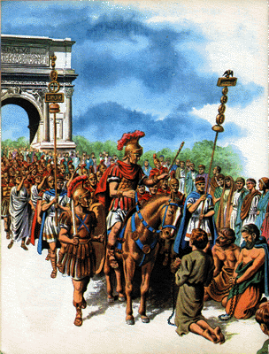
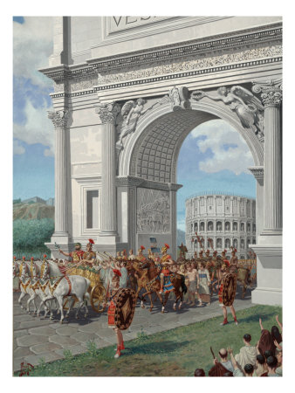
A Roman Triumphal Procession

Slide 4
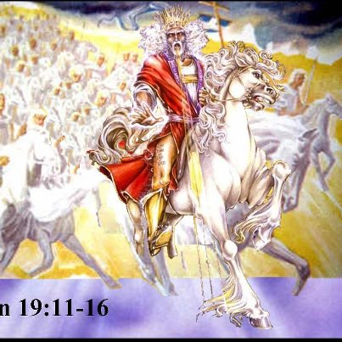
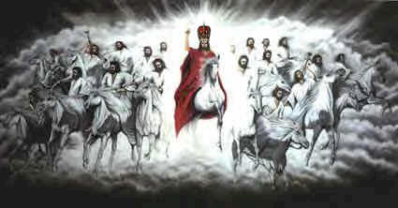
Christ always Leads us in Triumphal Procession
Rom.8:37
1 Cor.15:57
Rev.17:15
Rev.19:11-16

Slide 5
The Fragrance of the Knowledge of Him
Mk.16:15
Matt.28:19-20
Acts 1:8
Rom.1:15-16
Rom.10:13-18

Slide 6
To One a Fragrance from Death to Death
1 Cor.1:18-24
Foolish
Waste of Time
Nonsense
Reminder of Eternity – Hang Head, Ashamed, Look Away

Slide 7
To the Other a Fragrance from Life to Life
1 Cor.1:18-24
Every Time Gospel Preached, Songs sang, L.S., Word Taught
Aroma of Life
Rejoice
Stand in Awe of Him
Humbled, Grateful

Slide 8
The Final Victory Procession
Hear the Gospel of Christ, Mk.16:15
Believe in Jesus Christ, Acts 16:31
Repent and Turn to God, Acts 17:30
Confess Jesus as Lord, Matt.10:32
Be Baptized, I Pet.3:21
----------------------------------
Be Faithful Unto Death, Rev.2:10
If Err: Repent and Pray God, Acts 19:18

