Slide 1
Saved By Grace
It Does Not Mean
God’s Part
What it Does Mean
Saved By Faith
Man’s Part

Slide 2
Define Grace:
Graciousness (as gratifying), of manner or act (abstract or concrete; literal, figurative or spiritual; especially the divine influence upon the heart, and its reflection in the life; including gratitude): - acceptable, benefit, favour, gift, grace (-ious), joy liberality, pleasure, thank (-s, -worthy)
Good will, loving-kindness, favour
Of the merciful kindness by which God, exerting his holy influence upon souls, turns them to Christ, keeps, strengthens, increases them in Christian faith, knowledge, affection, and kindles them to the exercise of the Christian virtues

Slide 3
Saved By Grace
Affirmed Many Places
Acts 15:11
Romans 3:24
Romans 4:4
Eph.1:7
Eph.2:1-8
Titus 3:7
Heb.2:9

Slide 4
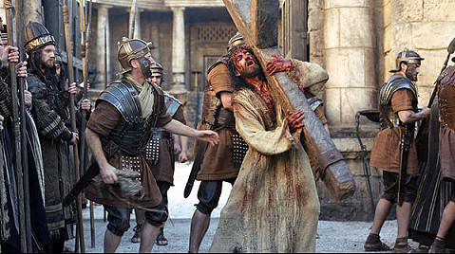
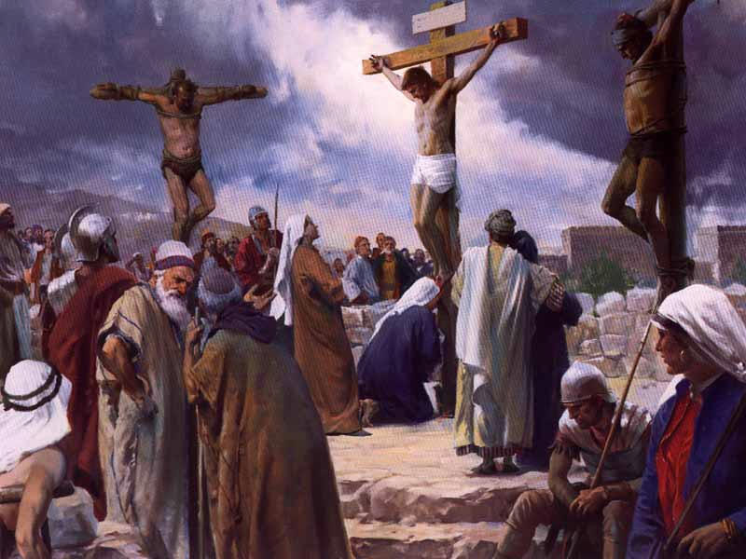
Costly Grace
Matt.26:36-46
No Alternate Plan
Matt.26:51-54
Could Have Stopped It
Matt.27:26-35
Horrible Pain, Costly Grace

Slide 5
Would You Accept His Grace?
Hear the Gospel of Christ, Rom.10:17
Believe in Jesus Christ, Acts 16:31
Repent and Turn to God, Acts 17:30
Confess Jesus Before Men, Acts 8:37
Be Immersed for Forgiveness, Acts 2:38
------------------------
Grow In The Grace & Knowledge, 2 Pet.3:18
If Err As a Christian: Repent & Pray God, Acts 19:18

