Slide 1
Lame Sacrifices
Malachi Chapter 1

Slide 2
Background of Malachi
After the Return From Captivity, Rebuilt the Temple, Rebuilt the Walls, Story of Esther
432 BC
Last of the O.T. Prophets
Vs.1, Malachi means “My Messenger”
God Loved Israel, vs.2-5 cf.Rom.9:12-16

Slide 3
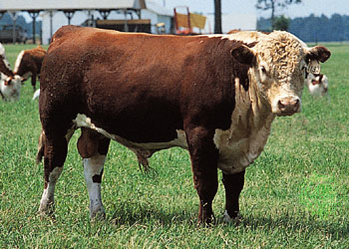
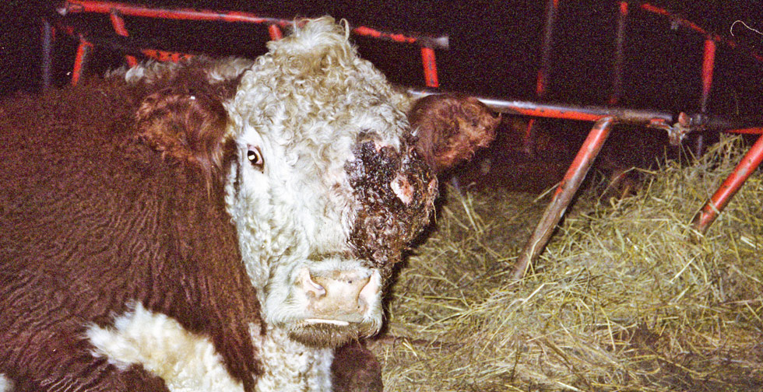
Attitudes and Offerings Were Wrong
Vs.6, Honor Parents, Ex.20:12
Vs.6-7, Despise, Hold in Contempt
Sacrifice – Without Blemish Lev.1:3, 3:1, 22:17-25
Vs.8, Lame Sacrifices
Try it on Governor
Vs.9, Ask Lord to Bless?
Vs.10, Any Godly Jealousy?
Vs.12, Disrespect Lord’s Table
Vs.13, Weariness – Snuff at, To puff, to blow

Slide 4
Lame Sacrifices Today
Come to Service When We Want to, Haphazard
Give God Leftovers and Crumbs of Our Prosperity
Sleep Through a lot Services – “Hoot Owls”
½ Study for the Bible Classes
Memorize Prayers that are Empty
Feel Worship is a Drudge, Burden; “Root Canal”
Mumble Through the Song Service, Heart not in it
Lord Supper is a Boring Repetition, Empty Ritual
Resent Having to Give God any of OUR money
Hearts Light up for Closing Prayer – Out of Here

Slide 5
Worship and Service God Wants
Recognize Him as a Great King, 1:14, 1:11, Heb.11:27
Give a Pure Offering, 1:11, Real, Genuine, Sincere
Hear and Lay it Up in our Heart, ch.2:2
Let it be a Response of Love, 1 Jn.4:19, 5:3, Mt.11:28-30, Gen.29:20
Have an Attitude of Gratitude, Lk.17:11-19, Ps.13:6
Come with Gladness and Joy, Ps.122:1, Phil.3:3

Slide 6
The Scheme of Redemption
Hear the gospel of Christ, Matt.7:24
Believe in Jesus Christ, Rom.5:1
Repent and Turn to God, Luke 24:47
Confess Jesus Before Men, Rom.10:9-10
Be Baptized, Mark 16:16
----------------------------
Be Thou Faithful Unto Death, Rev.2:10
If Err From The Truth: Repent and Pray God, Ac.19:18

