Slide 1
Welcome to Our Services

Slide 2
Let Us Worship In Song
Song Leader – Chris Craig
First Song #
Second Hymn #
Opening Prayer –
Song Before the Lesson #
Invitation Hymn #

Slide 3
“Hatred is a Cancerous Emotion”
Hostility; by implication a reason for opposition: enmity, hatred. To detest. Odious.
A feeling of strong antagonism and dislike, generally malevolent and prompting to injury (the opposite of love); sometimes born of moral resentment. Alike in the Old Testament and New Testament, hate of the malevolent sort is unsparingly condemned.
Of malicious and unjustifiable feelings toward others, whether toward the innocent or by mutual animosity.

Slide 4
Hatred is of the Flesh (not of the Spirit)
Gal.5:19-21
Titus 3:3
Hateful – General Attitude
Hating One Another – Specific people

Slide 5
Hatred – A Cancer of the Soul
Murderous Spirit – 1 Jn.3:11-15, Num.35:20-23, Gen.37:2-11
Prevents us From Loving God, 1 Jn.4:20-21
Self Deceiving Attitude, 1 Jn.2:9-11, Prov.10:18, Prov.26:24-26
We Hurt Ourselves the Worst, Prov.26:27, Esther 5:9-14
Stir Up Trouble, Prov.10:12
Words are Used to Vent Hatred, Ps.109:3
Haters of God, Rom.1:30
Hatred Truly is Like a Cancer
We Can Hate Sin, Heb.1:9, Rev.2:6

Slide 6
God’s Plan of Salvation
Hear the gospel of Christ, Acts 18:8
Believe in Jesus Christ, Acts 16:31
Repent and Turn to God, Acts 17:30
Confess Jesus Before Men, Acts 8:37
Be Baptized For Forgiveness, Acts 2:38
---------------------------------
Cleave Unto The Lord, Acts 11:23
If Err From The Truth: Repent & Pray God Acts 8:22

Slide 7
This Do In Remembrance of Me
And when he had given thanks, he brake it, and said, Take, eat: this is my body, which is broken for you: this do in remembrance of me.
After the same manner also he took the cup, when he had supped, saying, This cup is the new testament in my blood: this do ye, as oft as ye drink it, in remembrance of me.
For as often as ye eat this bread, and drink this cup, ye do show the Lord's death till he come. 1Cor.11:24-26

Slide 8
The Collection
“But this I say, He which soweth sparingly shall reap also sparingly; and he which soweth bountifully shall reap also bountifully.
Every man according as he purposeth in his heart, so let him give; not grudgingly, or of necessity: for God loveth a cheerful giver.” 2 Cor.9:6-7

Slide 9
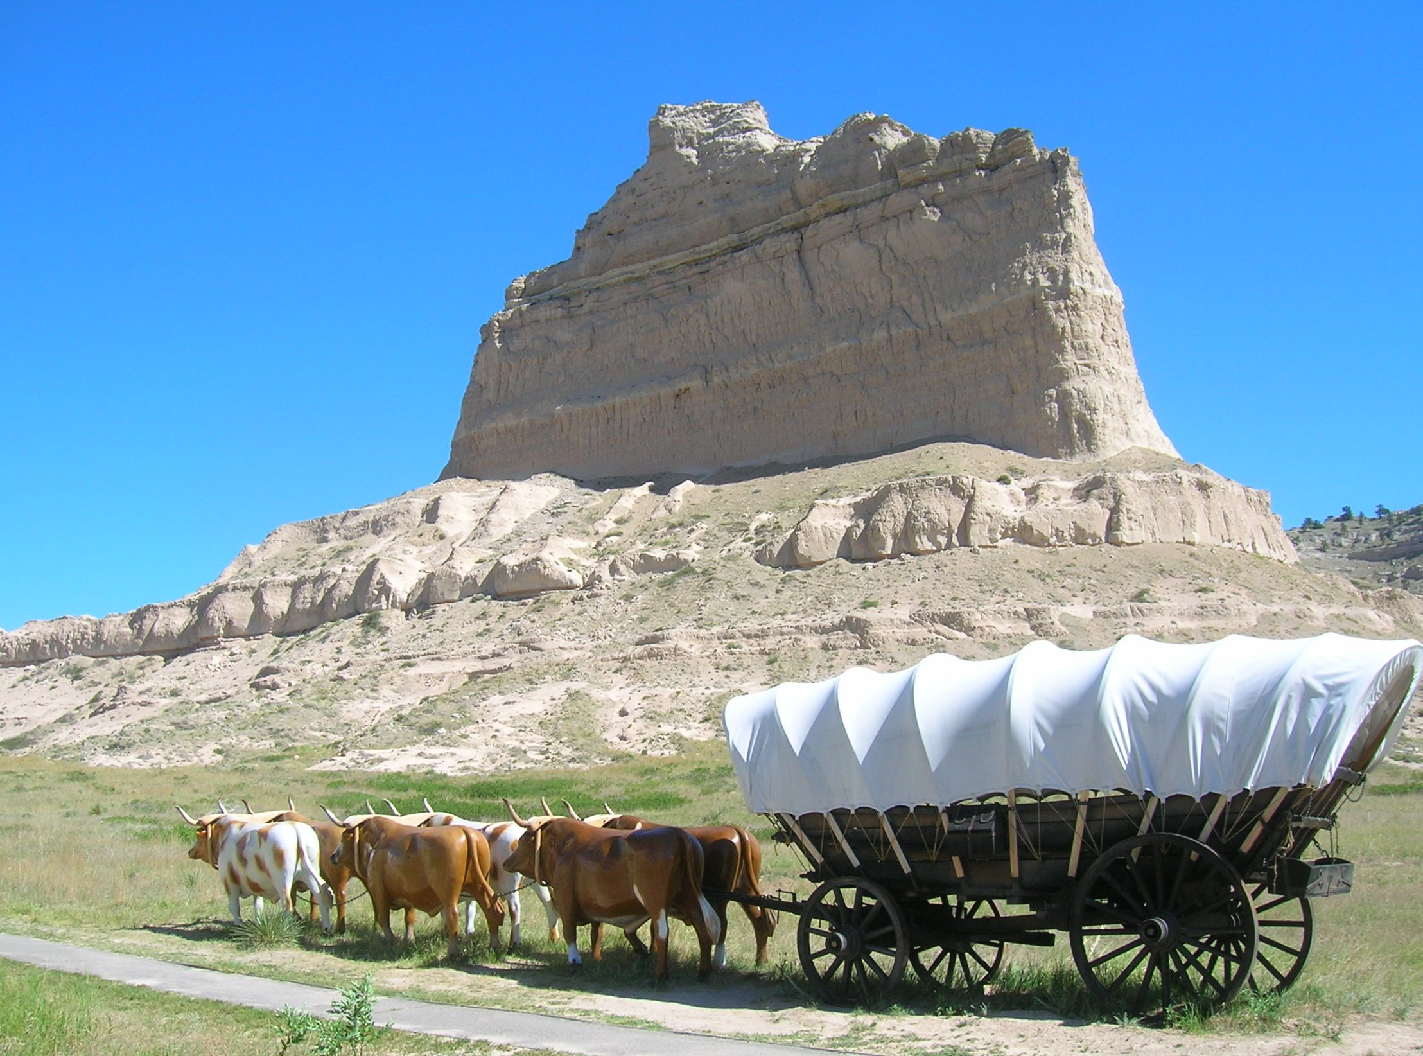
Thanks For Coming Out

