Slide 1
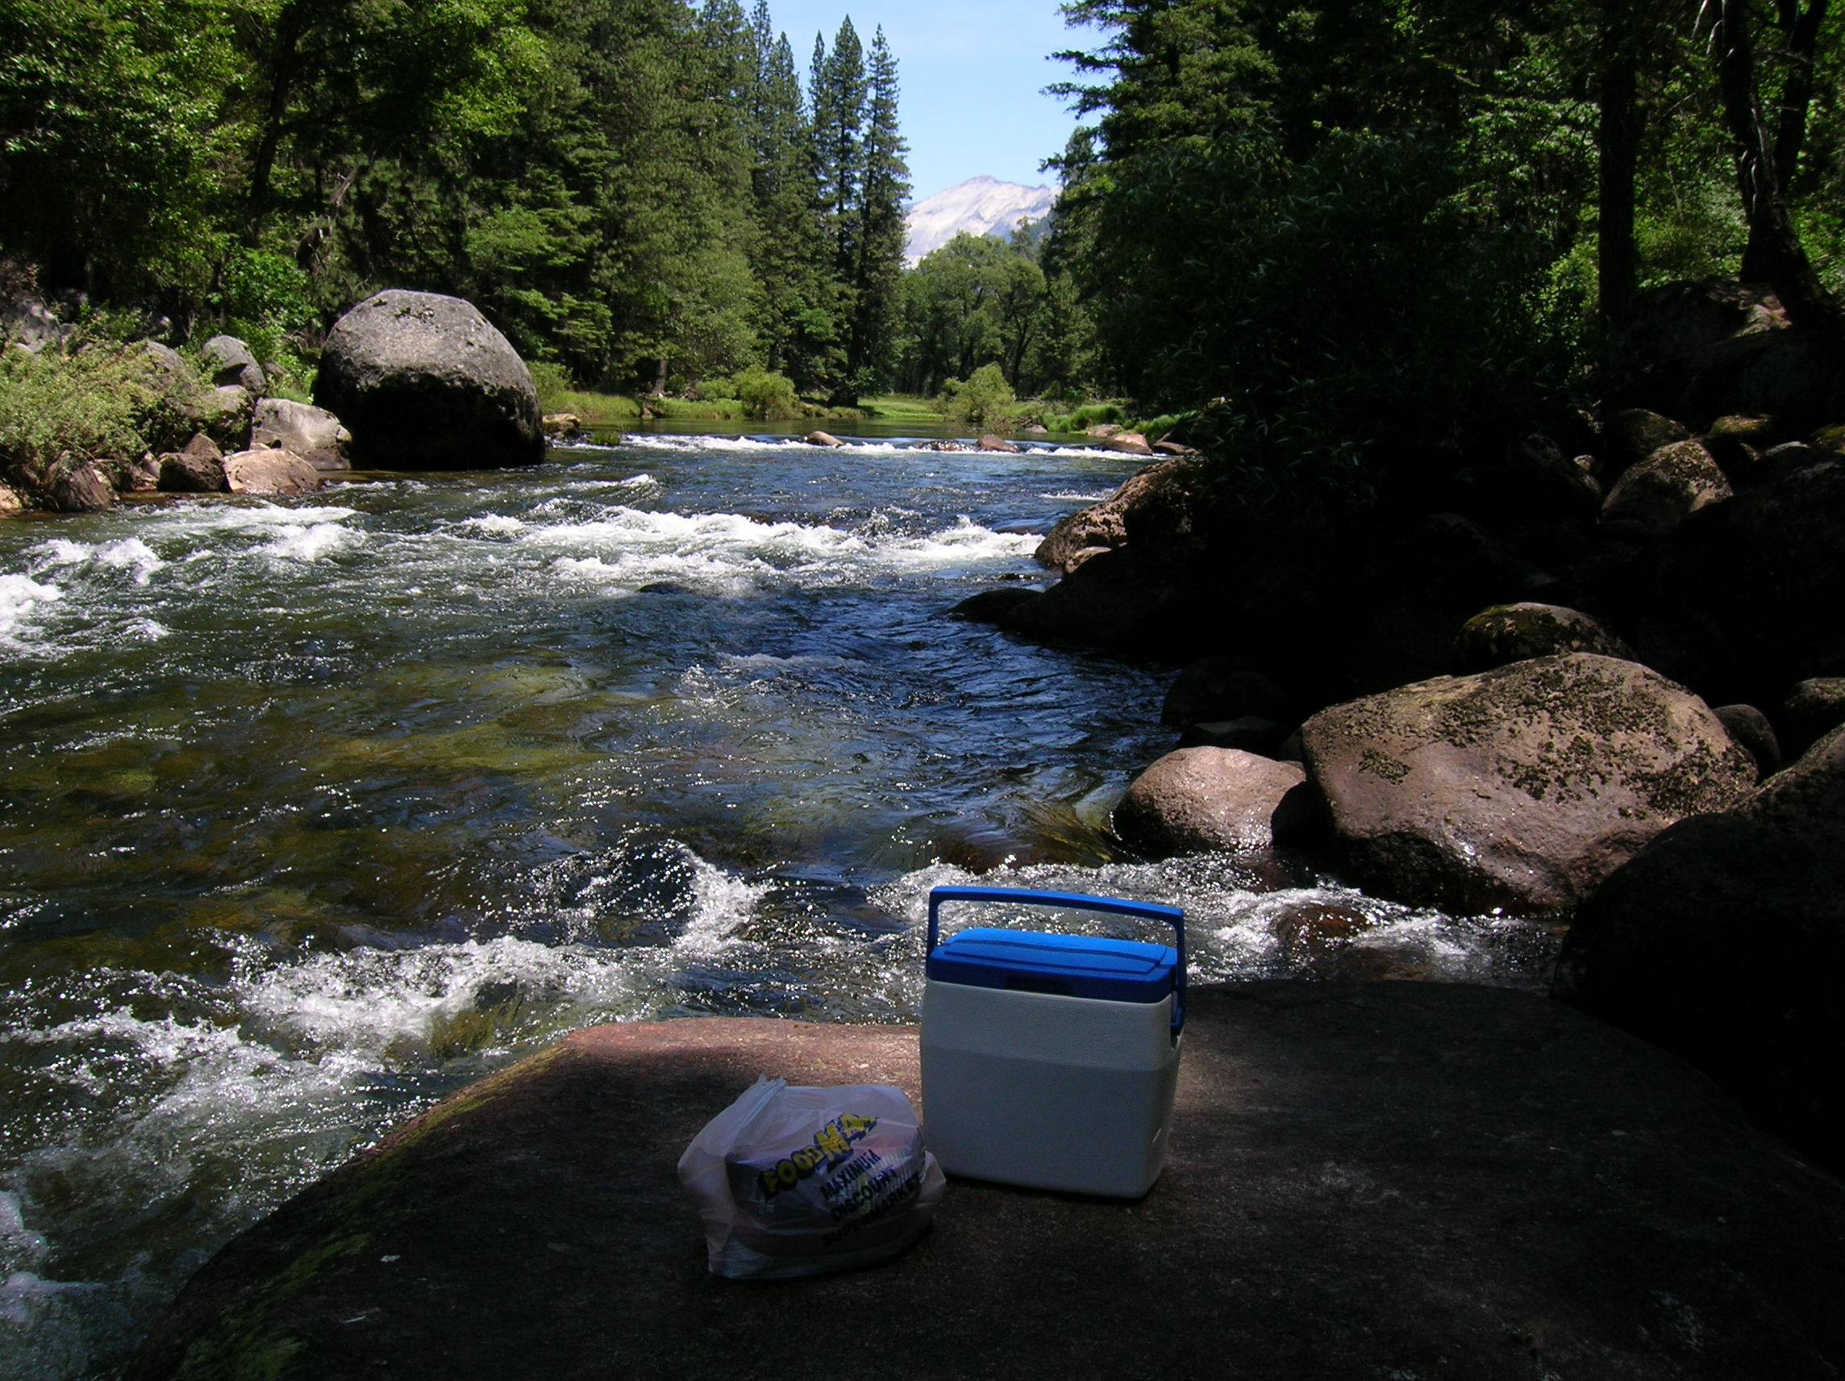
Welcome To Our Services
A Picnic Rock in Yosemite National Park

Slide 2
Let Us Exalt Him in Song
Song Leader – Chris Craig
First Song #
Second Song #
Opening Prayer -
Song Before The Lesson #
Invitation Song #

Slide 3
How Readest Thou?
Luke 10:25-37

Slide 4
4 Observations About the Phrase: How Readest Thou?
Some: Never Read the Bible
Some: What they Read, What they See are Different
Some: Read and See the Truth, But Their Practice Differs
Some: Read and See the Truth and Endeavor to Live It

Slide 5
Apply Various Passages and Topics: How Readest Thou?
John 10:25-30, Once Saved Always Saved
Acts 16:30-31, Just Believe on The Lord
1 Cor.11:23-26, How Often L.S.?
Eph.5:19, We can Praise God with Piano
Drinking is Ok, Just Don’t Get Drunk, 1Pet.4:3-4
Acts 2:38, Don’t Have to be Baptized

Slide 6
The Scheme of Redemption
Hear the Gospel of Christ, Acts 18:8
Believe in Jesus Christ, Rom.1:16
Repent and Turn to God, Acts 26:20
Confess Jesus Before Men, Matt.10:32
Baptized Into Christ, Gal.3:26-27
-----------------------------
Grow And Be Faithful, Matt.10:22
If Err From The Faith: Repent and Pray God Acts 8:22

Slide 7
This Do In Remembrance of Me
Is.53:3 He was despised, and rejected of men; a man of sorrows, and acquainted with grief: and as one from whom men hide their face he was despised; and we esteemed him not.
Is.53:4 Surely he hath borne our griefs, and carried our sorrows; yet we did esteem him stricken, smitten of God, and afflicted.
Is.53:5 But he was wounded for our transgressions, he was bruised for our iniquities; the chastisement of our peace was upon him; and with his stripes we are healed.

Slide 8
The Collection
“Now concerning the collection for the saints, as I have given order to the churches of Galatia, even so do ye.
Upon the first day of the week let every one of you lay by him in store, as God hath prospered him, that there be no gatherings when I come.” 1Cor.16:1-2

Slide 9
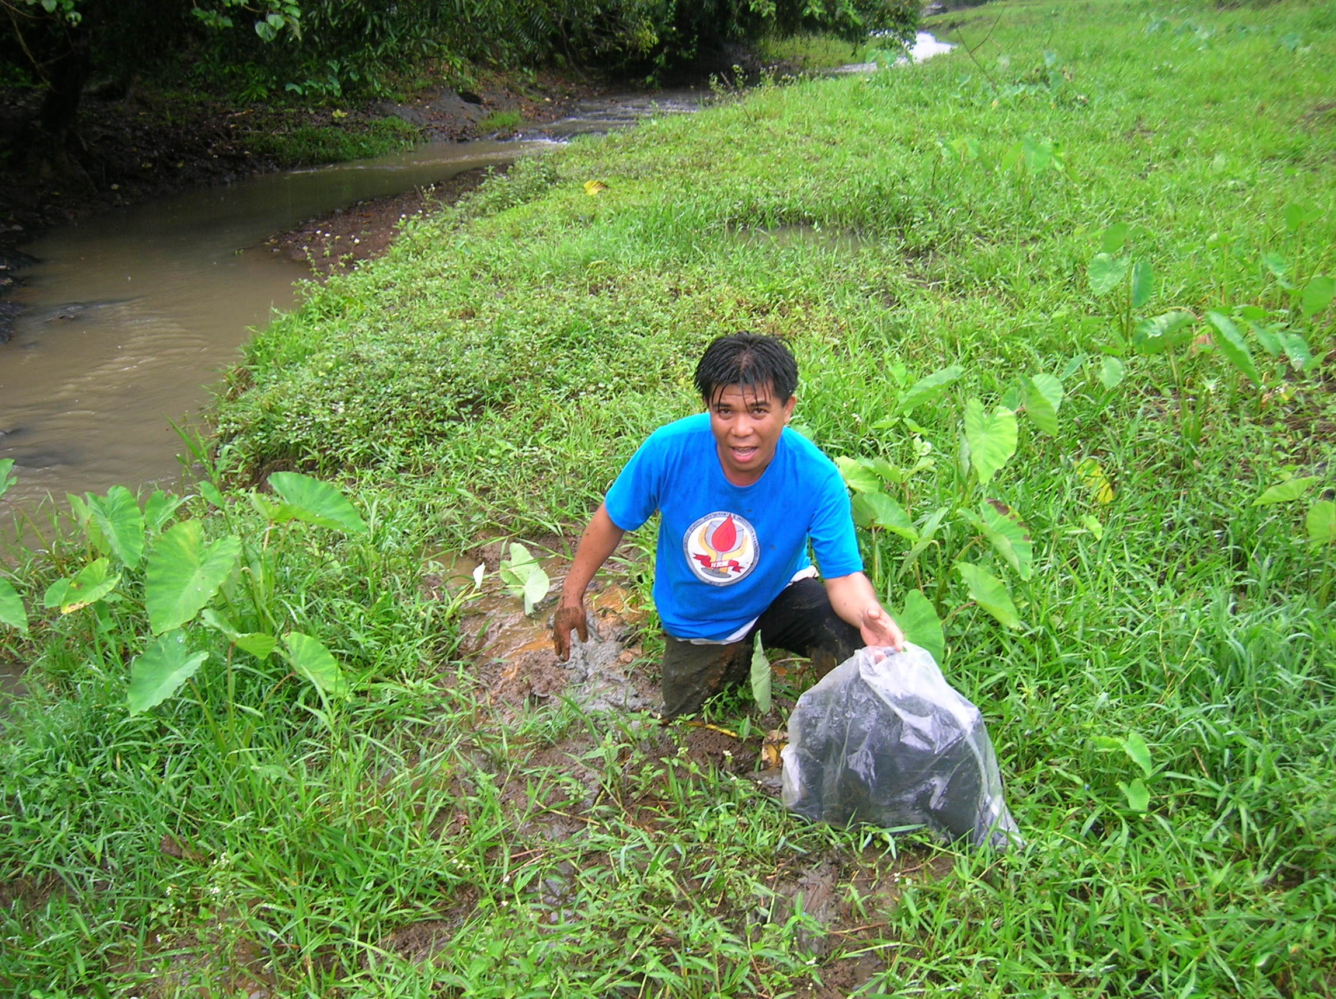
Thank You For Coming
Jhun Bautista in Quick Mud

