Slide 1
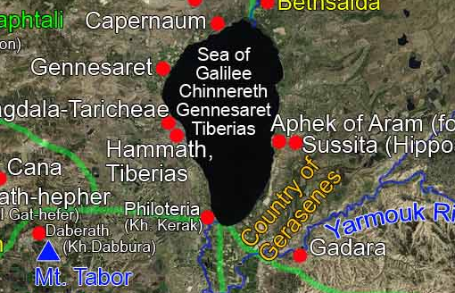
“Great Things The Lord Has Done”
Mark 5:1-20

Slide 2
Personal Evangelism
Personal, for I must do it
Evangelism is telling the Good News
Go and Tell your Friends Mk.5:19-20, 1 Pet.2:9-10
Early Church did, Acts 8:3-4, 1 Thess.1:7-8, Phil.1:12-14
They Told Whole World, Rom.10:17,18, Col.1:23
People Might Reject, Rom.10:16-21, Mt.7:13-14
Speak out of Conviction, 2 Cor.4:13, Jer.20:7-9
The Power is in the Word, 2 Cor.4:5-7, Rom.1:16
Seek The Lord’s Help, Matt.9:37,38, Col.4:3-6
How do we do it? What are the Magic Words…
Would You Like to Study the Bible?

Slide 3
The Plan of Salvation
Hear the Gospel of Christ, Acts 2:22
Believe in Jesus Christ, Rom.5:1
Repent and Turn to God, Luke 13:3
Confess Jesus Before Men, Matt.10:32
Baptized Into Christ, I Pet.3:21
-----------------------------
Grow And Be Faithful, 2 Pet.3:18
If Err From The Faith: Repent and Pray God I Jn.1:9

