Slide 1
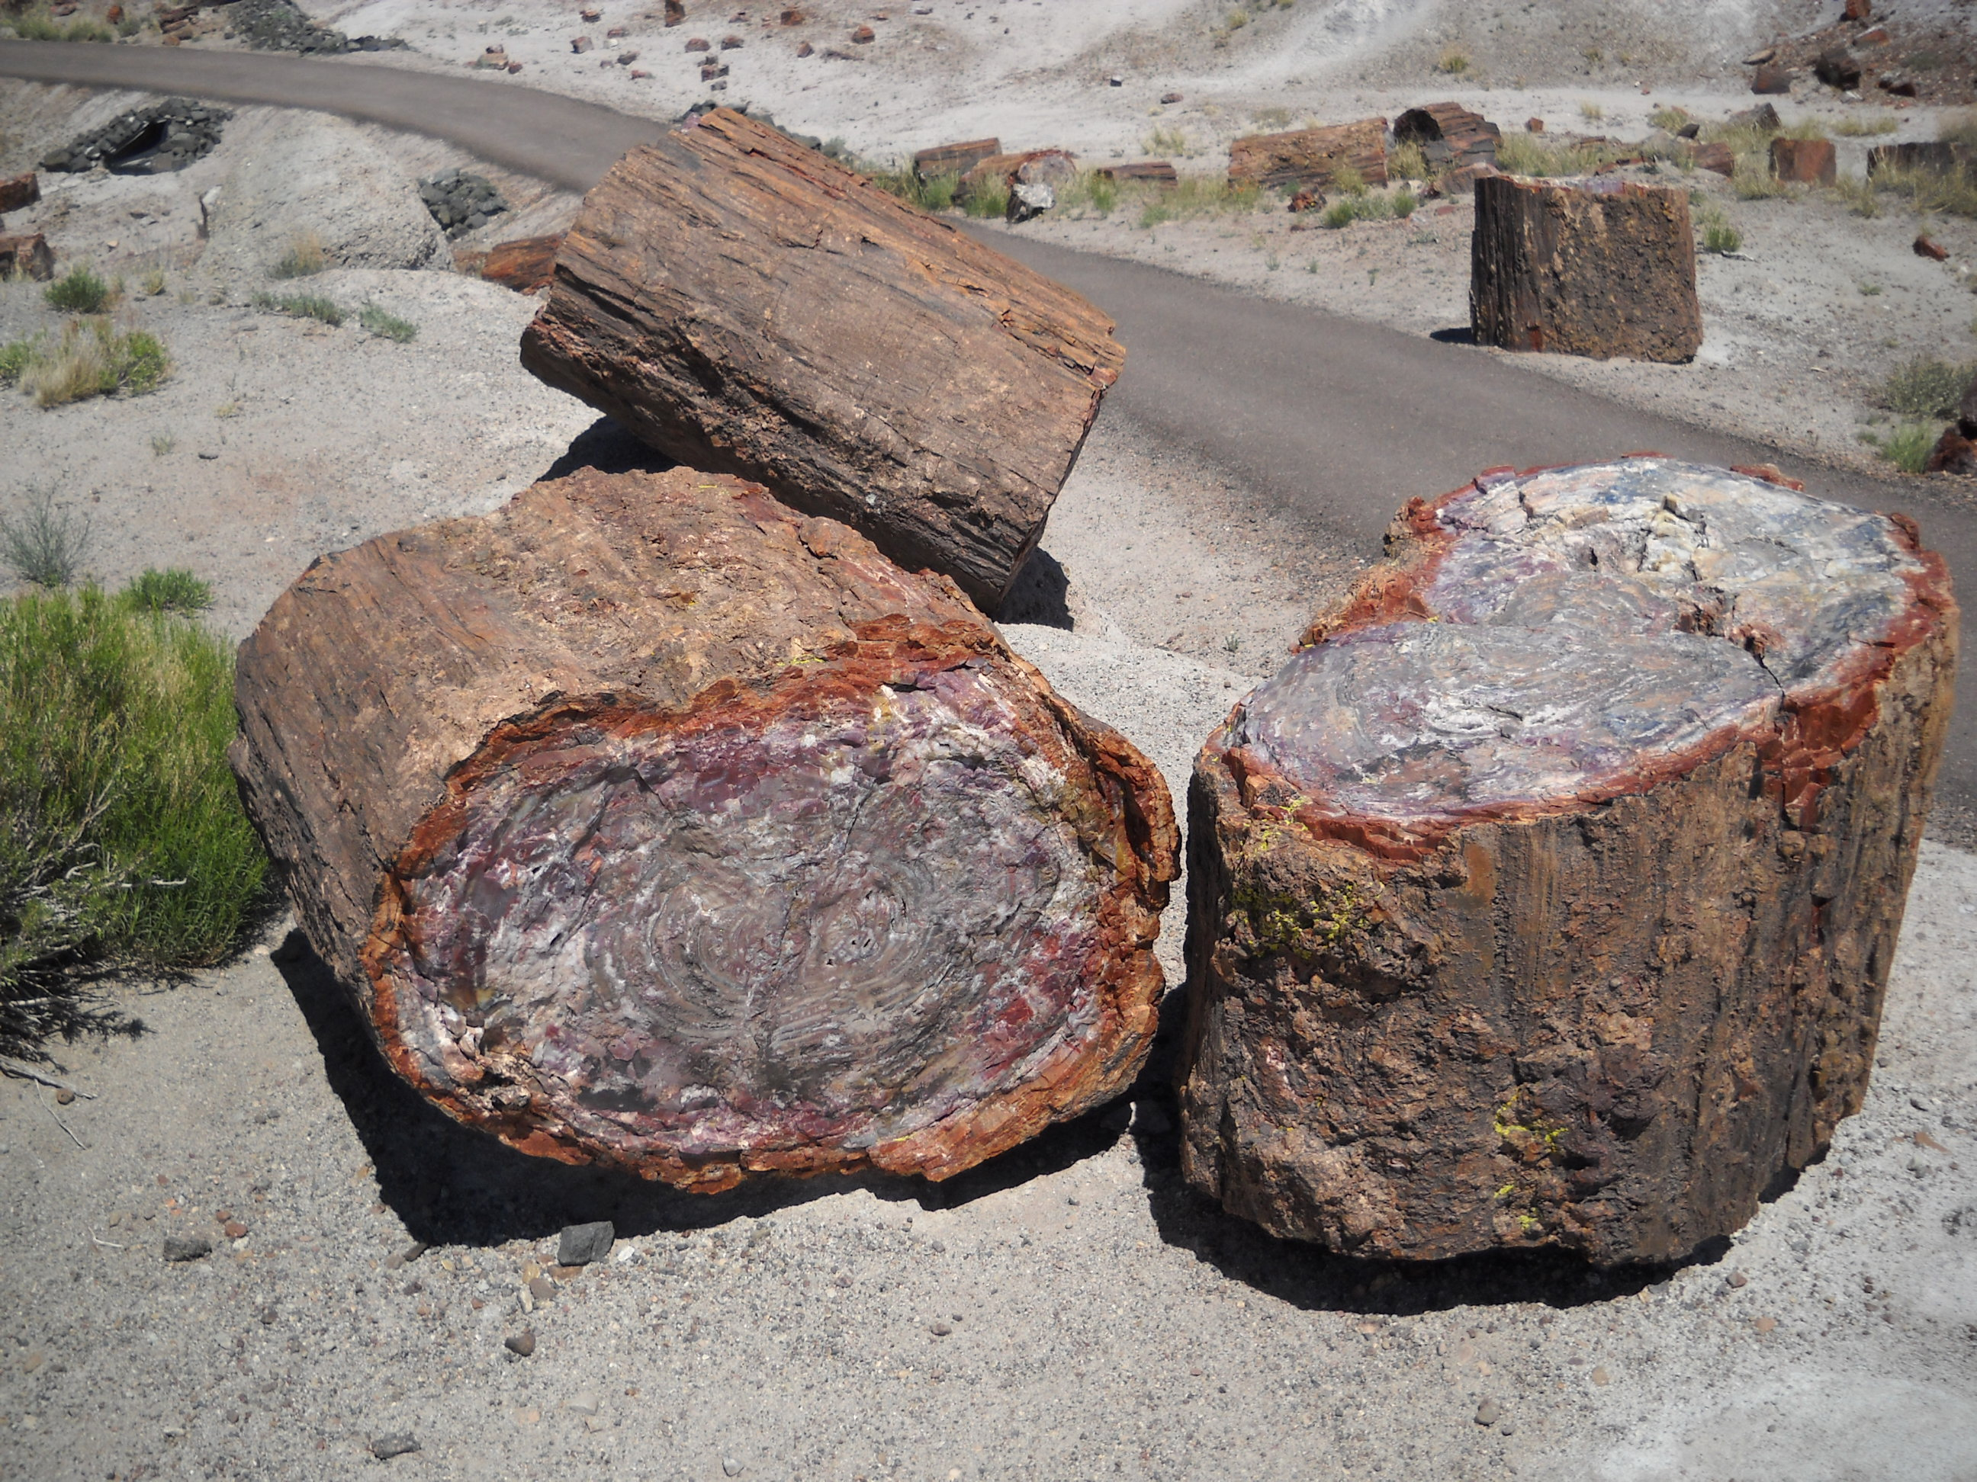
Welcome To All
Petrified Forrest National Park

Slide 2
Let Us Worship In Song
Song Leader – John Scott / Chris Craig
First Hymn # 267
Second Song # 406
Opening Prayer – Roy Reynolds
Song Before the Lesson # 455
Invitation Hymn # 319
Closing Song # 232

Slide 3
“Earnestly Contend For the Faith”
The Last of the N.T. Postcards: Jude

Slide 4
Earnestly Contend for the Faith
Vs.1-2 Introduction
Vs.3-4 The Purpose of Writing
Contend for the Faith
Deal with the False Teachers
Vs.5-7 Examples of Disobedience
Vs.8-16 Description of Evil Men
Vs.17-23 Exhortations to Faithfulness
Vs.24-25 Conclusion

Slide 5
The Plan of Salvation
Hear the Gospel of Christ, Rom.10:17
Believe in Jesus Christ, Acts 16:31
Repent and Turn to God, Acts 17:30
Confess Jesus Before Men, Acts 8:37
Baptized Into Christ, I Pet.3:21
---------------------------------------------
Grow And Be Faithful, 1 Pet.2:2
If Err as a Christian: Repent and Pray God 1 Jn.1:9

Slide 6
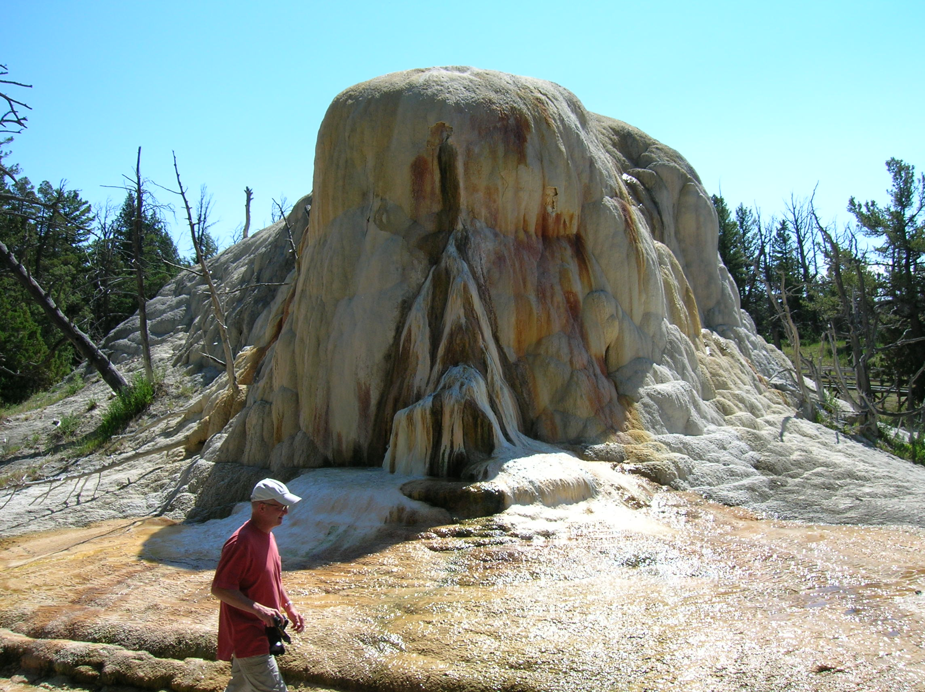
Thanks For Coming
Yellowstone National Park

