Slide 1
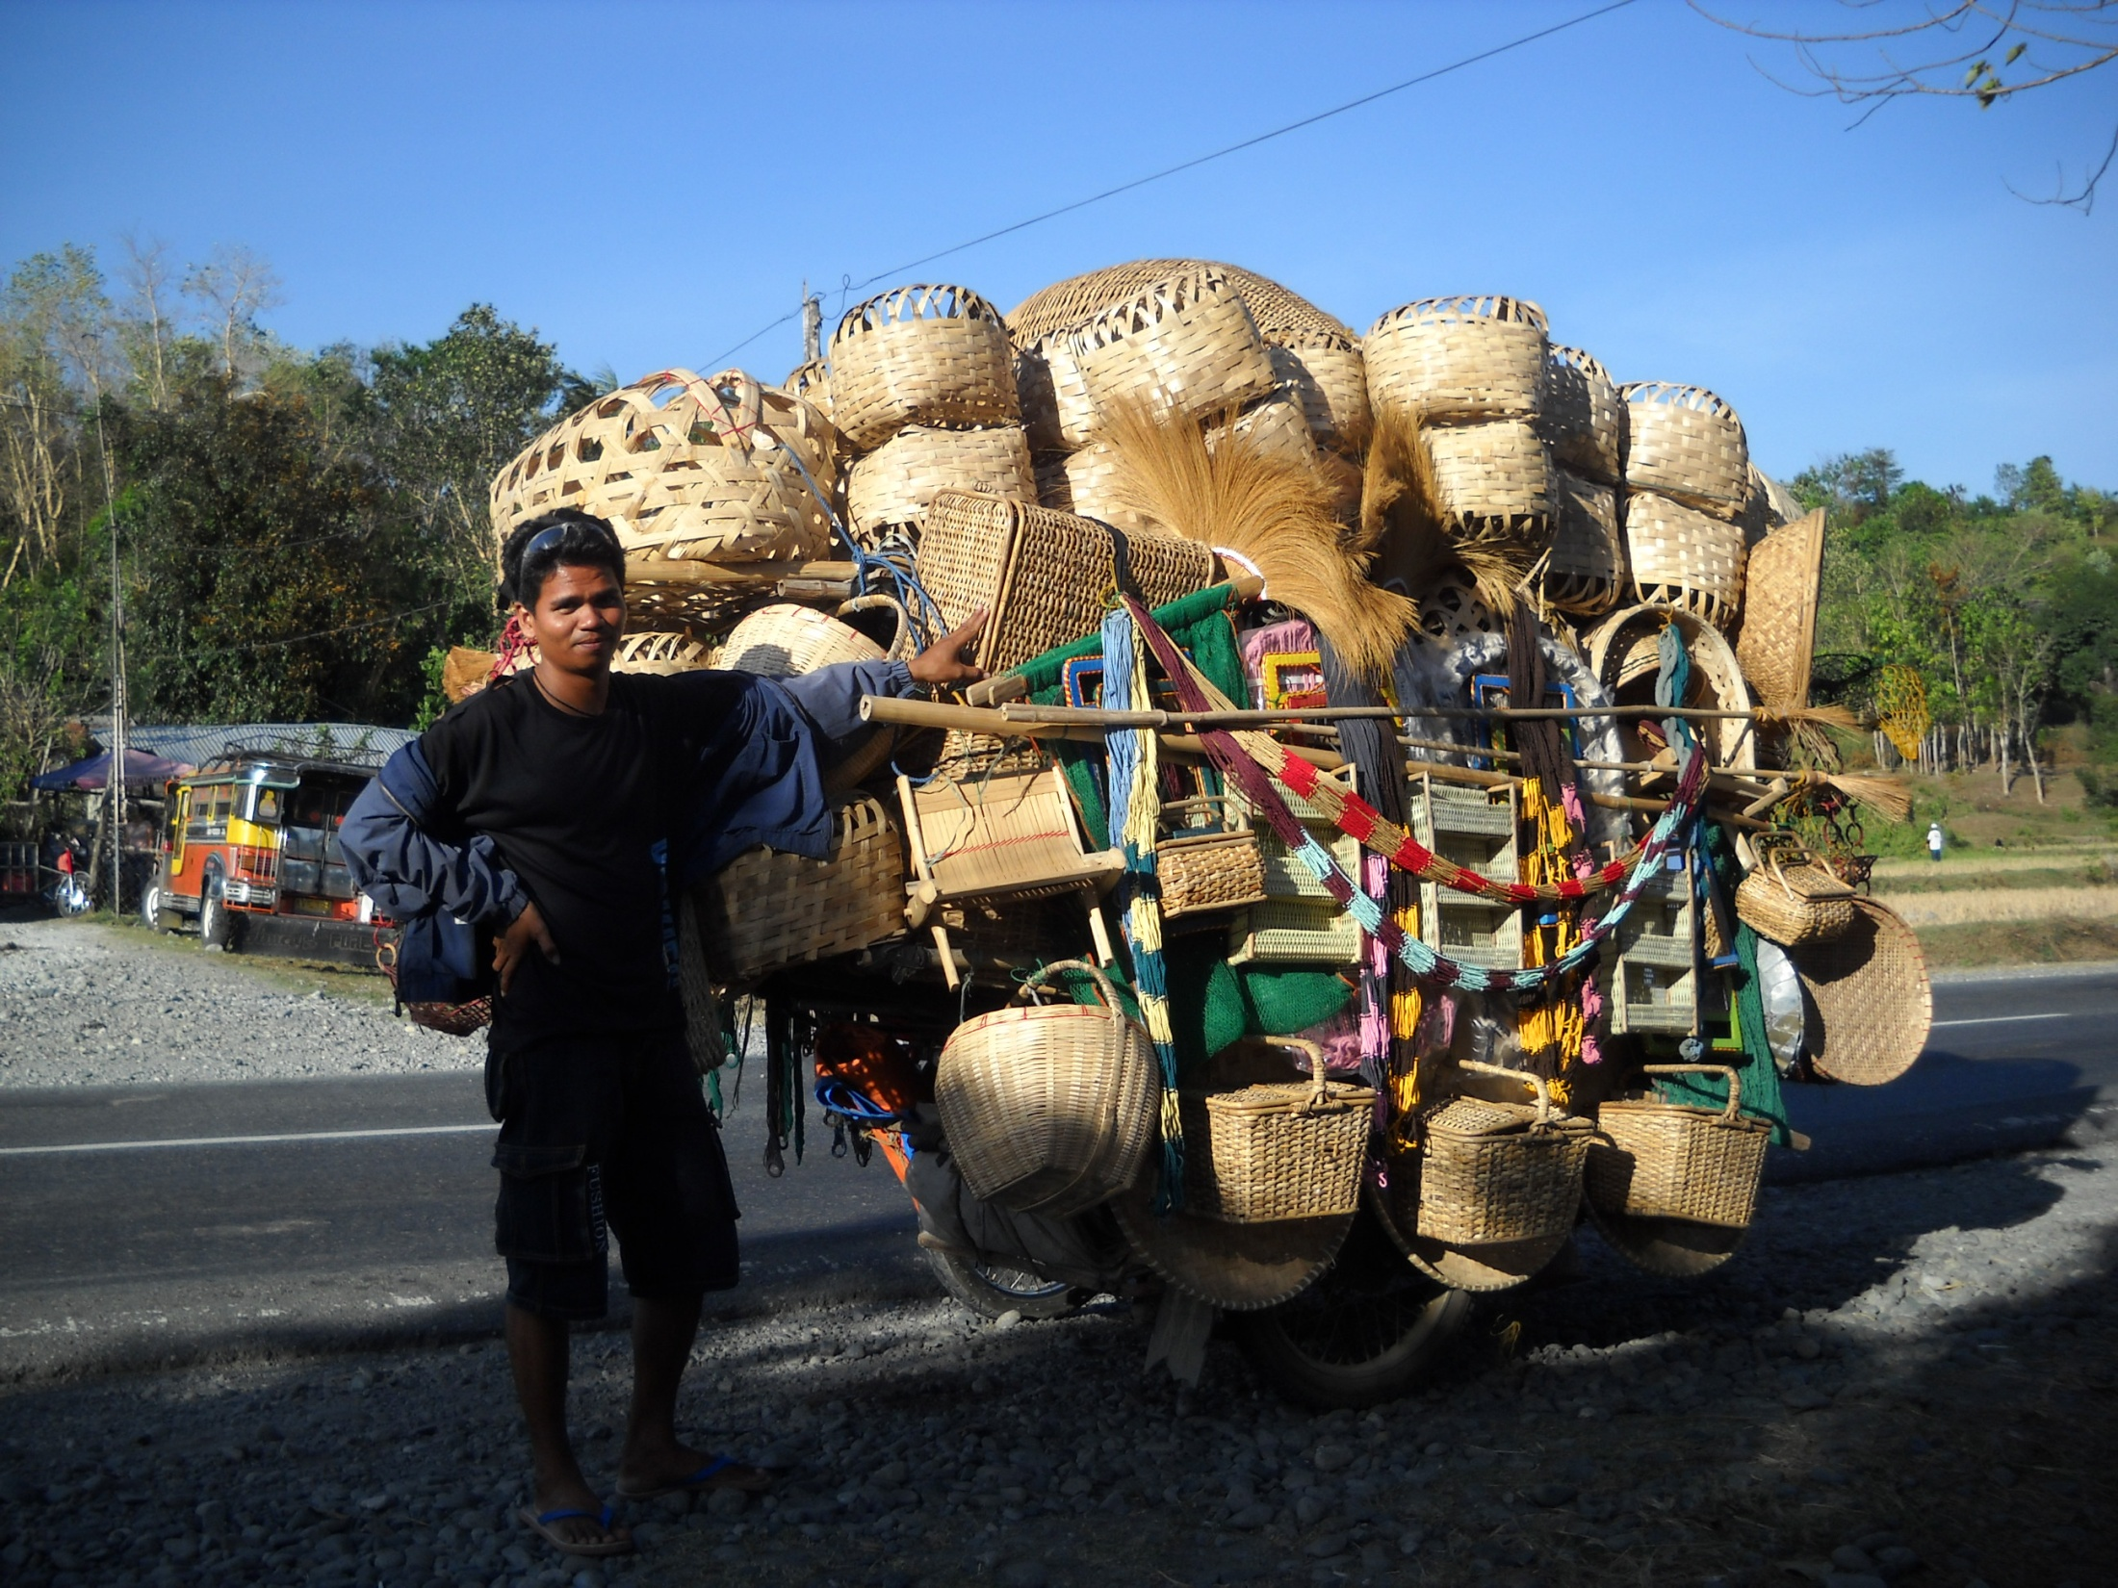
Welcome To Our Services

Slide 2
Let Us Worship God in Song
Song Leader – Andy Powell
First Hymn #
Second Song #
Opening Prayer -
Song before the Lesson #
Invitation Song #

Slide 3
The Kingdom of God
The word “kingdom” is found 162 X in the N.T. Most refer to the Rule of Christ
Define: Properly royalty, that is, (abstractly) rule, or (concretely) a realm (literally or figuratively): - kingdom, reign. Royal power, kingship, dominion, rule. Primarily a abstract noun denoting sovereignty, royal power, dominion. Then by metonymy a concrete noun denoting the territory or people over whom the king rules.
Many times it refers to the church, but sometimes more broadly the Rule of Jesus over all things. Illustration, Temple: 1Cor.3:17, 6:19, Eph.2:21-22

Slide 4
The Rule of King Jesus Mt.28:18, Eph.1:20-23, 1Pet.3:22
Angels, Heb.12:22-23
The Church, Heb.12:22-23
O.T. Saints, Mt.8:11, Rev.14:4
Kings of the Earth, Rev.1:5, 17:14
All Creation, Rev.5:12-13
Death & Hades, Rev.1:18, 1 Cor.15:25-26
The Wicked, Ps.2:9, Ps.110:1-4
Satan & his Angels, Mt.12:29, Heb.2:14-15, 1 Jn.3:8

Slide 5
When Did His Rule Began?
Eph.3:1-21
Matt.3:1-2
Mk.1:15
Acts 11:15
E
E
Coronation of Jesus
Is.2:2-4
Dan.2:44
Dan.7:13-14
2 Sam.7:12-17
Ps.2:6
Zech.6:12-13
Acts 2:30-36

Slide 6
Some Various Aspects of the Kingdom
Not of this world, Jn.18:36
Spiritual in Nature, Rom.14:17
It is Within, Lk.17:20-21
It is Open for All, Is.2:2
Cannot be Shaken, Heb.12:28
Christ Rules and is Priest now, Zech.6:12-13

Slide 7
Things We Can Do For the Kingdom
We Can Pray for it’s Expansion, Matt.6:10
We Can Preach the Gospel of the Kingdom, Mt.4:23, Acts 8:12, Acts 20:25, Acts 28:31
Seek it First in Our Lives, Matt.6:33
We Can Enter Into It By the New Birth, John 3:3-8, Col.1:12-13

Slide 8
Is Jesus King in Your Life?
Hear the Gospel of Christ, Acts 18:8
Believe in Jesus Christ, Acts 16:31
Repent and Turn to God, Acts 17:30
Confess Jesus as Lord, Rom.10:9-10
Be Baptized, Ac.22:16
----------------------------------
Be Thou Faithful Unto Death, Rev.2:10
If Err: Repent and Pray God Acts 8:22

Slide 9
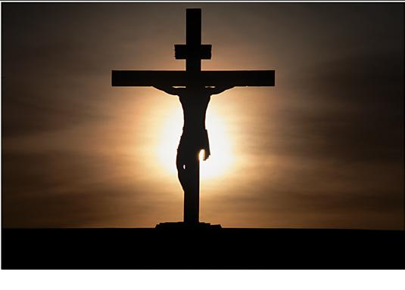
This Do In Remembrance of Me
And as they were eating, Jesus took bread, and blessed it, and brake it, and gave it to the disciples, and said, Take, eat; this is my body. And he took the cup, and gave thanks, and gave it to them, saying, Drink ye all of it; For this is my blood of the new testament, which is shed for many for the remission of sins. Matt.26:26-28

Slide 10
The Collection
“Now concerning the collection for the saints, as I have given order to the churches of Galatia, even so do ye.
Upon the first day of the week let every one of you lay by him in store, as God hath prospered him, that there be no gatherings when I come.” 1 Cor.16:1-2

Slide 11
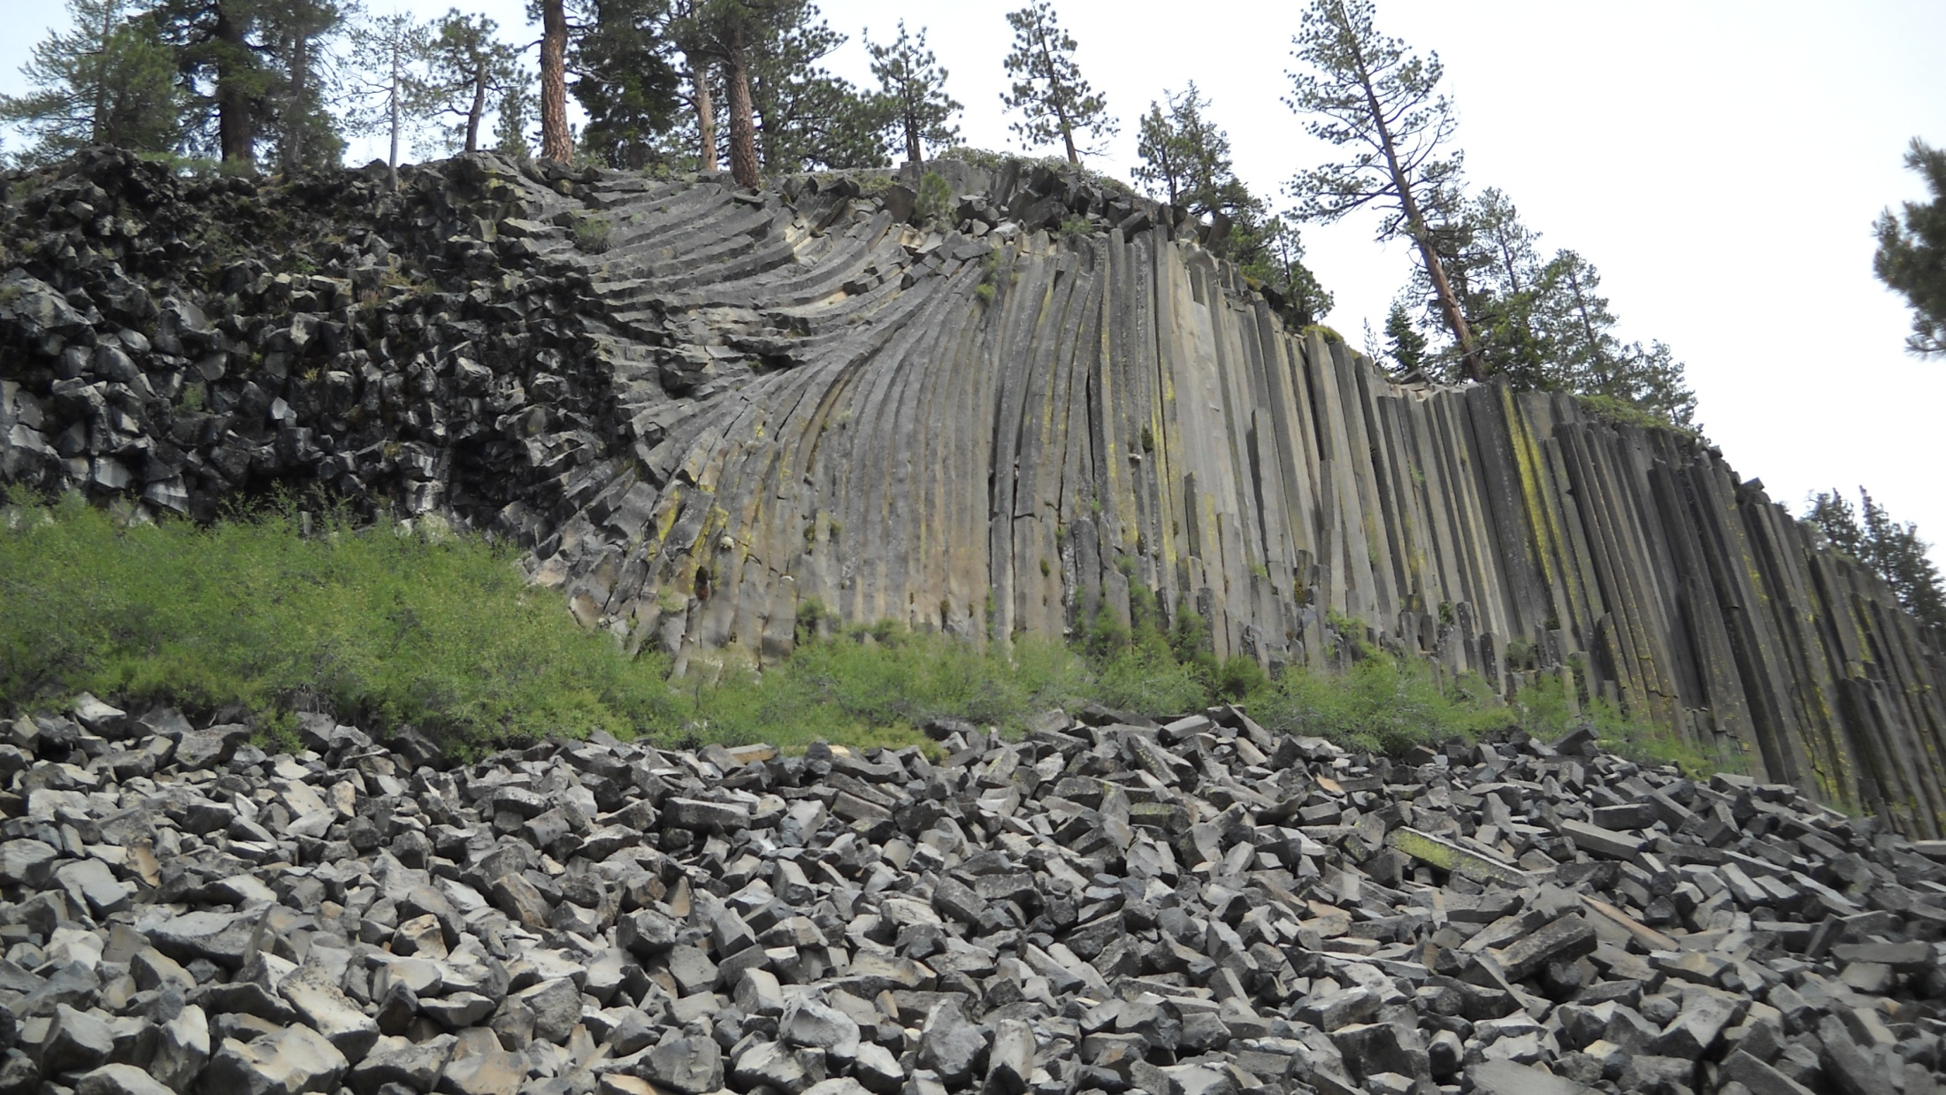
Thanks For Coming Out Today
Nursing Home Service at 2:00 PM

