Slide 1
Welcome to Our Services

Slide 2
Let Us Worship In Song
Song Leader – Zac Miller
First Hymn # 190
Second Song # 589
Opening Prayer – Clinton Thompson
Song Before the Lesson # 480
Invitation Hymn # 317
Closing Song # 463

Slide 3
“That Ye May Know That Ye Have Eternal Life”
1 John
Chapter 1 – The Testimony, Your Joy Maybe Full, Fellowship
Chapter 2 – Knowing God, Love Not the World, Antichrists
Chapter 3 – Children of God ~ The Children of the Devil
Chapter 4 – Try the Spirits, God is Love
Chapter 5 – Believing in the Son of God, Victory in Christ
1 John 5:11-12

Slide 4
“That Ye May Know That Ye Have Eternal Life”
Vs.11-13 ~God Wants Us to Know and To Have Eternal Life
Jn.6:47, Jn.10:10, Jn.17:3, Tit.1:2, Tit.3:7, 1 Jn.2:25
Have the Son  Have Life  Have Eternal Life (Rom.4:17)
Vs.14-15 ~ We Have Confidence in Prayer
Matt.21:22, Jn.14:14, 15:7, 16, Jn16:23-24, Eph.3:20, 1Jn.3:22
According to his Will? Matt.26:39, Text. Ask Amiss? Jm.4:2-3
Vs.16-17 ~ A Sin Unto Death ~ A Sin Not Unto Death
The Unpardonable Sin?
Vs.18 ~ Sin Not, 3:6 &9, Keep Yourself, 1 Tim.5:22, 1 Cor.9:27
Vs.19 ~ God’s Children, The Rest With Devil, Mt.4:8, Eph.2:1-3
Vs.20 ~ Jn.17:3. Vs.21 ~ Idols, Col.3:5, 1 Cor.10:14

Slide 5
Do You Have The Son?
Hear the Gospel of Christ, Acts 2:22
Believe in Jesus Christ, Acts 16:31
Repent and Turn to God, Acts 17:30
Confess Jesus Before Men, Acts 8:37
Baptized Into Christ, I Pet.3:21
---------------------------------------------
Grow And Be Faithful, 1 Pet.2:2
If Err as a Christian: Repent and Pray God 1 Jn.1:9

Slide 6
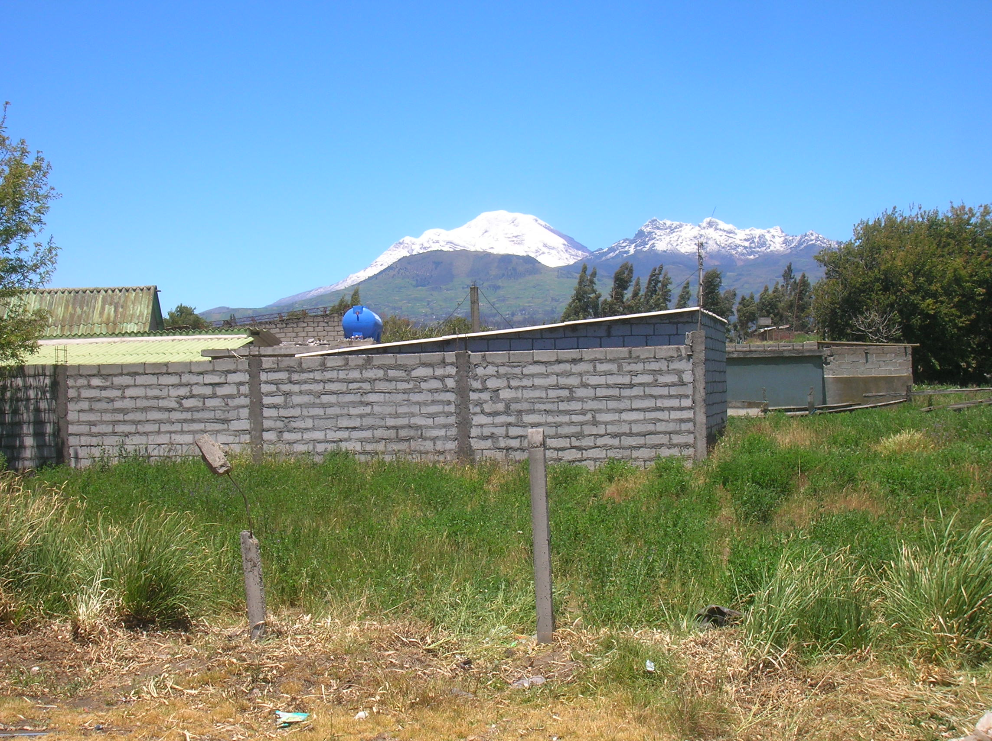
Thanks For Coming Out

