Slide 1
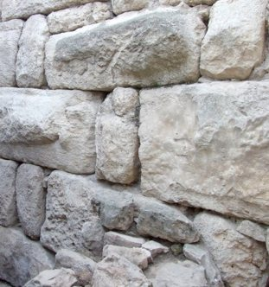

Slide 2
NEHEMIAH God’s Keys for Successful Rebuilding
Leadership

Slide 3
GOD REBUILDS BROKEN THINGS
A life of addiction (drugs, pornography)
Upbringing: physical or sexual abuse, neglect
Estrangement from family
Troubled marriage
Life after divorce
Broken friendships
New life into an old church
Dysfunctional family
Life after prison
Life-changing injury, illness, or surgery
Business on the ropes
Failing country and faltering economy
Church recovering from division
Faltering personal faith

Slide 4
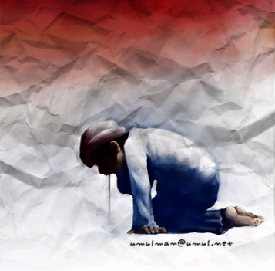
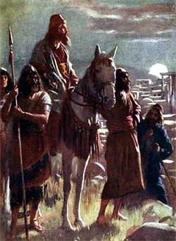
Successful Rebuilding calls for Good Leadership
Genuine concern for others
Walk with God
Understand the problem
Call others to the work
Lead the way
Committed to truth, confront evil
Maintain the vision

