Slide 1
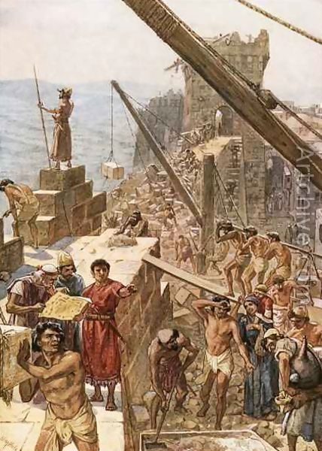
NEHEMIAH God’s Keys for Successful Rebuilding
People With A Mind To Work!

Slide 2
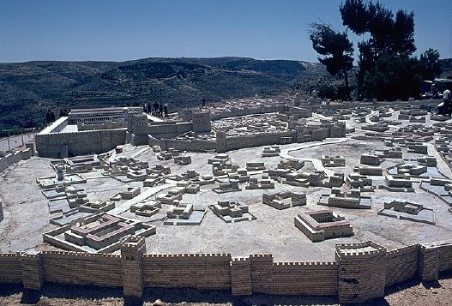
Jerusalem
2.1 miles in length 35 feet, average height 35 towers 8 gates

Slide 3
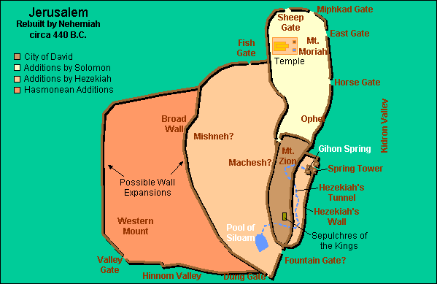
Walls rebuilt in just 52 days!
(Nehemiah 6:15)

Slide 4
Successful Rebuilders
Responsible People
Faithful People
Unknown People
People with a Mind to Work!

