Slide 1
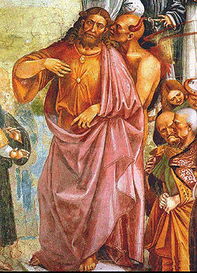
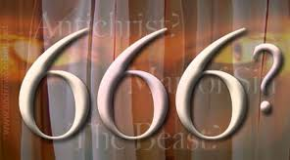
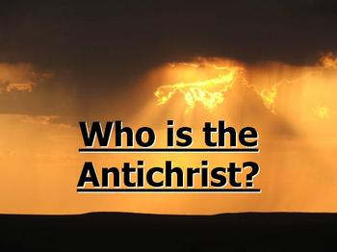
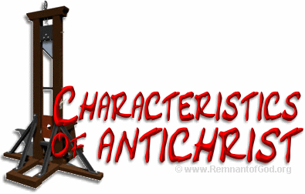
Antichrist

Slide 2
Antichrist
Meaning of Antichrist – Against, adversary, opponent, contra, the Messiah, the Anointed One
Many Have been “Identified” as The Antichrist
Last Time, Last Hour, Heb.1:1-2
Not Just One, I John 2:18, 22, 4:3, 2 John 7
“That Man of Sin” 2 Thess.2:3-7
“Antichrists”, vs.18 --- “They went out from us” vs.19

Slide 3
The Truly Anointed Ones
Anointing – Anything smeared on, unguent, ointment, usually prepared by the Hebrews from oil and aromatic herbs. Anointing was the inaugural ceremony for priests.
Used in Hospitality, Sickness, Consecration of Priests, Prophets and Kings.
Jesus Christ – Acts 4:27, Acts 10:38, Matt.3:16-17
We are anointed of God, vs.20, 2Cor.1:21-22
Miracles? Earnest? Spirit Inspired Truth
We are kings & priests I Pet.2:9

Slide 4
The Plan of Salvation
Hear the Gospel of Christ, Acts 2:22
Believe in Jesus Christ, Rom.5:1
Repent and Turn to God, Luke 13:3
Confess Jesus Before Men, Matt.10:32
Baptized Into Christ, I Pet.3:21
-----------------------------
Grow And Be Faithful, 2 Pet.3:18
If Err From The Faith: Repent and Pray God I Jn.1:9

