Slide 1
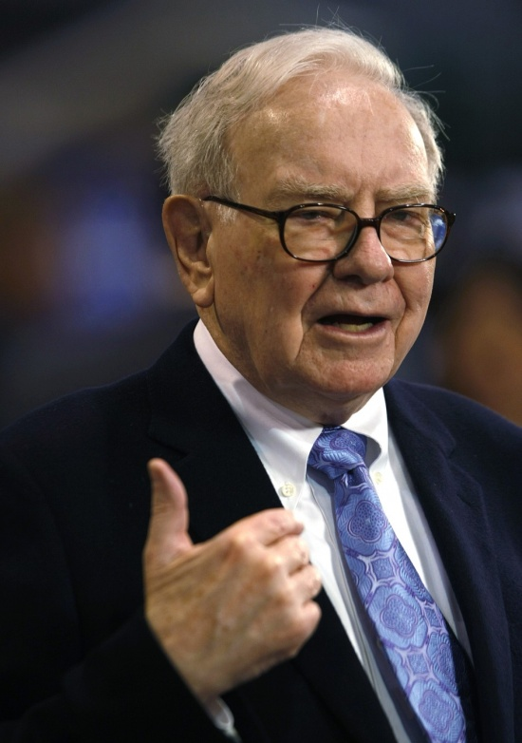
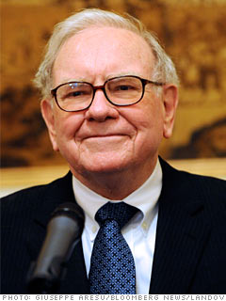
Focusing on Fundamentals
Basics Are Always Needed
Warren Buffet
CEO of Berkshire Hathaway
“The Oracle”

Slide 2
Focusing on Fundamentals
Fear of the Lord, Pr.1:7, Eccl.12:13-14, Ac.10:34-35
The Bible is Complete, 2 Tim.3:16-17, 2Pet.1:3
Repentance from Dead Works, Heb.6:1-2
Be a Willing Worker, Rev.14:1, 9-10
Love the Lord, Matt.22:35-40, 1Jn.4:19, 1Cor.16:22
Be a Servant to Others, Matt.20:25-28, Jn.13:14-17
Assemble for Worship, Heb.10:25, Ac.2:42; 11:26
The Power of Prayer, 1 Pet.3:10-12, 5:7
Be a Fisher of Men, Matt.4:18-19, Ac.8:4
Have Good Attitudes, Eph.4:1-3, Gal.5:22ff,

Slide 3
The Plan of Salvation
Hear the Gospel of Christ, Acts 18:8
Believe in Jesus Christ, Acts 16:31
Repent and Turn to God, Acts 17:30
Confess Jesus as Lord, Rom.10:9-10
Be Baptized, Ac.22:16
----------------------------------
Be Thou Faithful Unto Death, Rev.2:10
If Err: Repent and Pray God Acts 8:22

